Slide 1

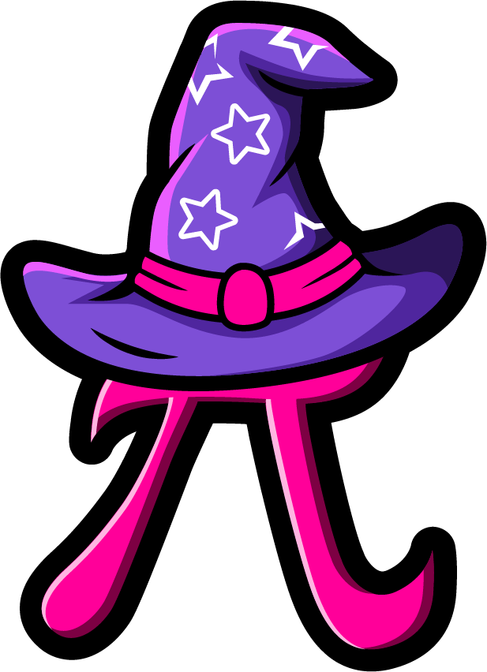
Lesson 5:
Assess and Review
www.arithmagicians.com

Slide 2



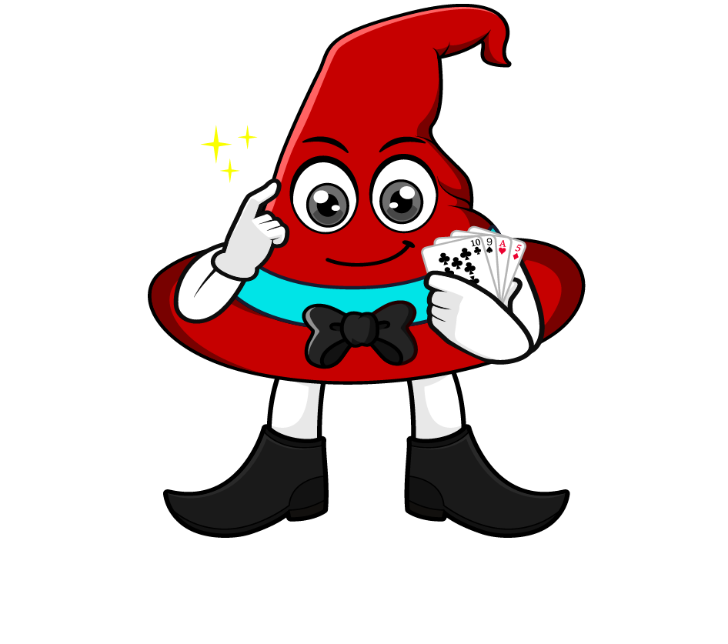
0.6 x 8000
I will multiply 0.6 by 1000 to make a whole number, then multiply by 8.
= 0.6 x 1000 x 8
= 600 x 8
= 4800
What’s the same & what’s different?
I will multiply 0.6 by 8 first, then multiply by 1000.
= 0.6 x 8 x 1000
= 4.8 x 1000
= 4800

Slide 3
Which strategy do you prefer? Why?
0.3 x 8000
= 0.3 x 1000 x 8
= 300 x 8
= 2400
= 0.3 x 8 x 1000
= 2.4 x 1000
= 2400

Slide 4


Your Turn
1) 6000 x 0.4 =
2400
5) 0.8 x 4000 =
3200
2) 0.2 x 4000 =
800
6) 7000 x 0.4 =
2800
6300
7) 0.7 x 7000 =
4900
3) 7000 x 0.9 =
4) 0.5 x 9000 =
4500
8) 3000 x 0.7 =
2100

