Slide 1
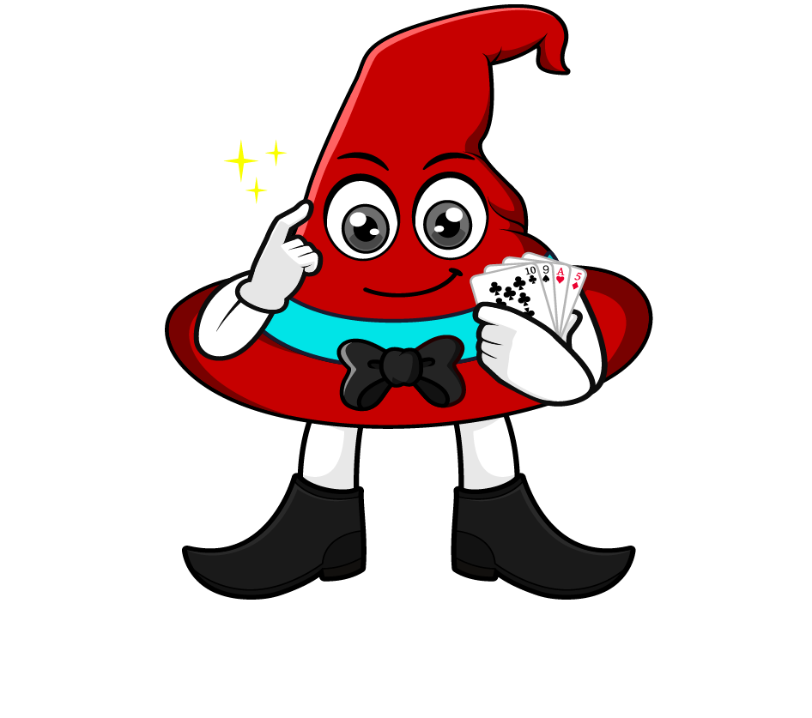

Lesson 1:
Recap: Multiply by 10, 100 & 1000
www.arithmagicians.com

Slide 2

Let’s recap what we have learnt so far?
1) To multiply a number by 10 each digit moves
to the left on a place value grid.
1
2) To multiply a number by 100 each digit moves
to the left on a place value grid.
2
3) To multiply a number by 1,000 each digit moves
to the left on a place value grid.
3

Slide 3

424,000
88,000
424
5,000
5
88
____ multiplied by 1,000 is equal to _______

Slide 4

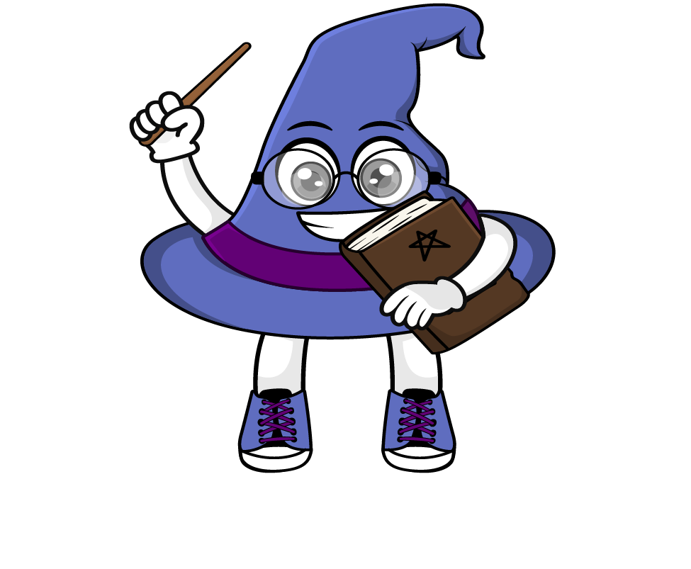
When we multiply by 1000, every digit moves three place to the left.
The place value chart shows the number 99
So we now have 99,000
99 x 1000 = 99,000
.
HTh
Th
H
T
O
t
h
th
.
9
9
9
9
0
9
9
0
0
0
0
0
0
0
0

Slide 5


Your Turn
72
86,000
1) 72 x 1 =
5) 86 x 1000 =
2) 72 x 10 =
720
6) 1000 x 7 =
7000
7,200
7) 44 x 1000 =
44,000
3) 72 x 100 =
4) 72 x 1000 =
72,000
8) 111 x1000=
111,000

