Slide 1
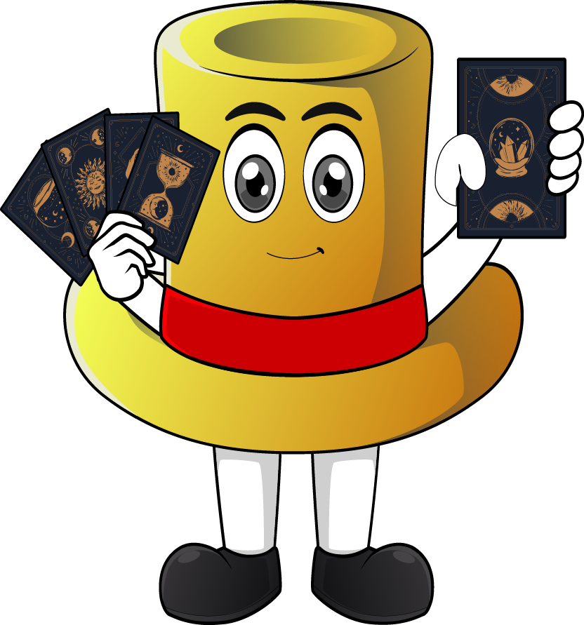

Lesson 2:
Recap: x3 table
(using: double + one more group strategy)
www.arithmagicians.com

Slide 2

-3
-3
-3
-3
-3
-3
-3
-3
-3
3
6
9
12
15
18
21
24
27
30
Get ready to count back in 3s

Slide 3


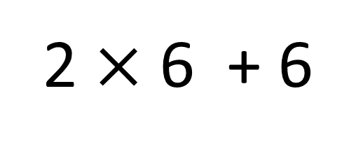
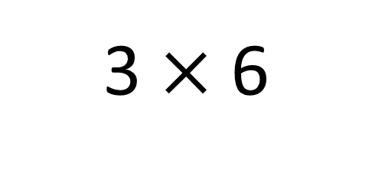
True
True or False
3 $×$ 6
=
2 $×$ 6 + 6
=
3
__ groups of 6 is the same as 2 groups of __ plus __ more
6
6

Slide 4
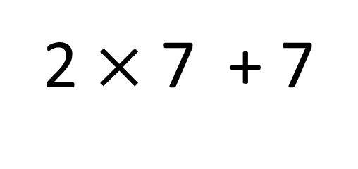
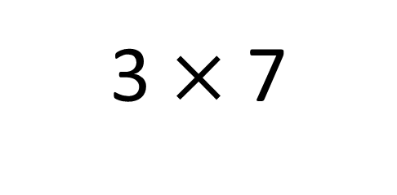
True
True or False
3 $×$ 7
=
2 $×$ 7 + 7
=
3
__ groups of 7 is the same as 2 groups of __ plus __ more
7
7

Slide 5


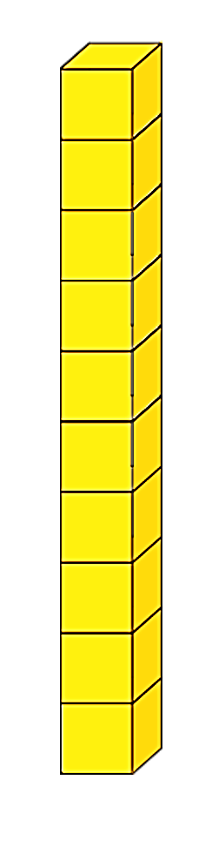
Great! What do I need to do first?
What do I do next?
I wan to solve 3 x 8 using the ‘double and one more group’ strategy.
Can you help?
+
+
+ 8 more
Double 8
= 24

Slide 6


Your Turn
Answer the questions below and
be ready to explain which strategy you used.
9
6) 8 x 3 =
24
1) 3 x 3 =
2) 3 x 7 =
21
7) 3 x 12 =
36
3) 9 x 3 =
27
8) 10 x 3 =
30
4) 3 x 0 =
0
9) 5 x 3 =
15
5) 11 x 3 =
33
10) 3 x 4 =
12

