Slide 1
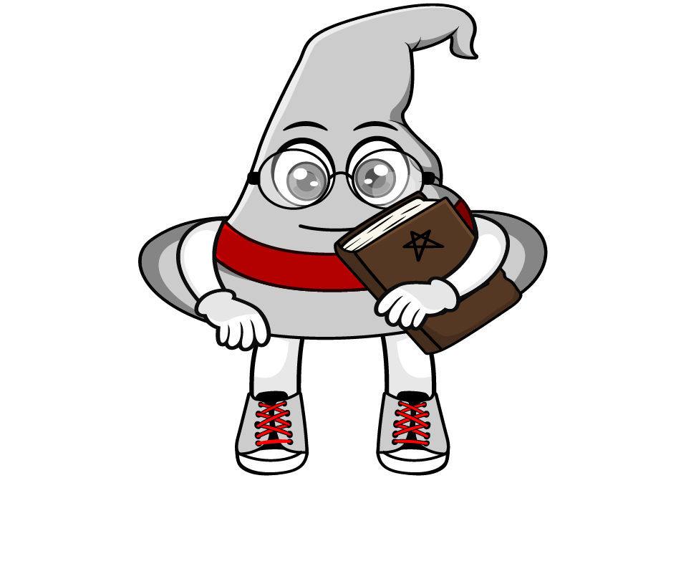

Lesson 2:
Recap: Repeated multiplication by 10
www.arithmagicians.com

Slide 2

38 x 10 x 10 x 10
.
HTh
Th
H
T
O
t
h
th
.
3
8
0
0
0
3
8
3
0
8
0
0
0
0
0
38 x 1000
x10
x10
x10
x10
x10
x10
x10
x10
x10
x10
x10
x10
x10
x10
x10
.
Th
H
T
O
t
h
th
HTh
.
3
8
0
0
0
x1000

Slide 3

Complete the sequence
320
32 × 10 = ______
× 10
3,200
______
× 10
32,000
______
× 10
320,000
______

Slide 4
Are these equal? Explain why.
7 × 1,000
= 7000
7 × 10 × 10 × 10
= 7000

Slide 5


Your Turn
1) 83 x 10 =
830
2) 83 x 10 x 10 =
8300
3) 83 x 100 =
8300
4) 83 x 10 x 10 x 10 =
83000
5) 83 x 100 x 10 =
83000
6) 83 x 1000 =
83000

