Slide 1
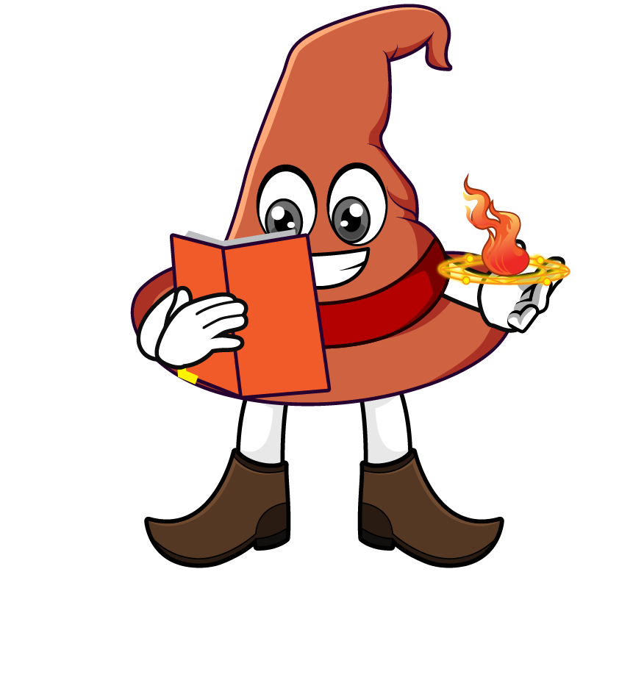

Lesson 4:
Recap: Missing numbers
www.arithmagicians.com

Slide 2

? X 51 = 51,000
1000 X 51 = 51,000
I notice that 51,000 is _____ times larger than 51
1000
So, 51 x ______ equals 51,000
1000

Slide 3
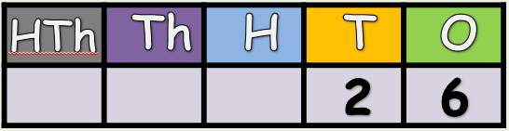

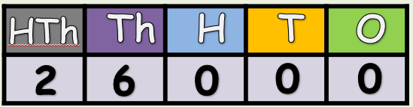
What is the
missing number?
x ?
X 1000

Slide 4
85,000 ÷ ? = 85
85,000 ÷ 1000 = 85
1000
I notice that 85,000 is ______ times larger than 85
So, 85000 ÷ ____ equals 85
1000

Slide 5
What is the
missing number?
÷ ?
÷ 1000

Slide 6


Your Turn
100
1) 82 x ? = 8,200
1000
2) 11,000 ÷ ? = 11
100
3) 44,000 ÷ ? = 440
55
4) ? x 1000 = 55,000
71,000
5) ? ÷ 1000 = 71

