Slide 1


Lesson 4:
7 x 3 table
(using: double + one more group strategy)
www.arithmagicians.com

Slide 2

+3
+3
+3
+3
+3
+3
+3
+3
+3
+3
0
3
6
9
12
15
18
21
24
27
30
Get ready to count up in 3s

Slide 3


True
Recap: True or False
7 $×$ 3 $=$ 3 $×$ 7

Slide 4

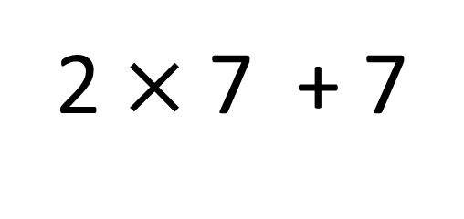
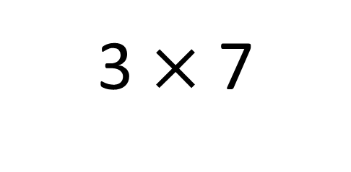
True
True or False
3 $×$ 7
=
2 $×$ 7 + 7
=
3
__ groups of 7 is the same as 2 groups of __ plus __ more
7
7

Slide 5


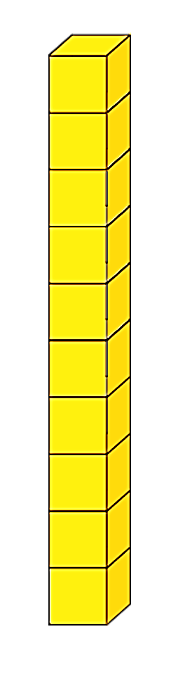
What do I do next?
I want to solve 3 x 7 using the ‘double and one more group’ strategy.
Can you help?
Great! What do I need to do first?
+
+
+ 7 more
Double 7
= 21

Slide 6


Your Turn
Do you have a different strategy?
Which strategy do you prefer? Why?
Show 3 different ways of solving 3 x 7
Skip count in 7s, three times
Double + one more
group strategy
+7
+7
+7
3 x 7 = 2 x 7 + 7
0
7
14
21
Skip count in 3s, seven times
+3
+3
+3
+3
+3
+3
+3
0
3
6
9
12
15
18
21

Slide 7
True or False:
3 x 7 = 2 x 7 + 3
False: What mistake
did Novice make?

