Slide 1


Lesson 1:
8 x 3 table
(Using skip counting)
www.arithmagicians.com

Slide 2

+3
+3
+3
+3
+3
+3
+3
+3
+3
+3
0
3
6
9
12
15
18
21
24
27
30
Get ready to count up in 3s

Slide 3


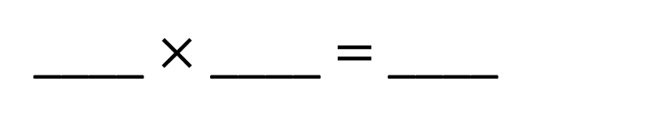
8
There are ____ groups.
3
There are ____ in each group.
24
There are ____ altogether.
24
____ $×$ ____ $=$ ____
8
3

Slide 4

3
There are ____ groups.
8
There are ____ in each group.
24
There are ____ altogether.
24
____ $×$ ____ $=$ ____
3
8

Slide 5

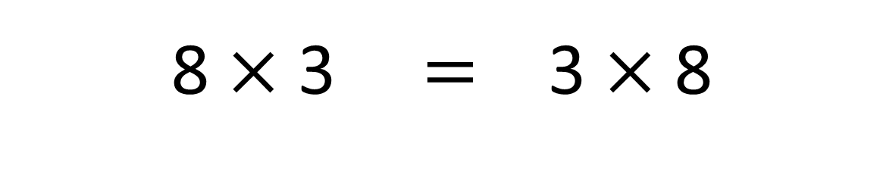
True
True or False
8 $×$ 3 $=$ 3 $×$ 8

Slide 6


Solve: 8 x 3
Jasmin:
I am going to skip count in 8s, three times.
+8
+8
+8
0
8
16
24
Amy:
I am going to skip count in 3s, eight times.
+3
+3
+3
+3
+3
+3
+3
+3
0
3
6
9
12
15
18
21
24
Which method is quicker – why?

Slide 7


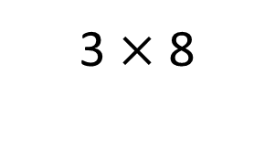
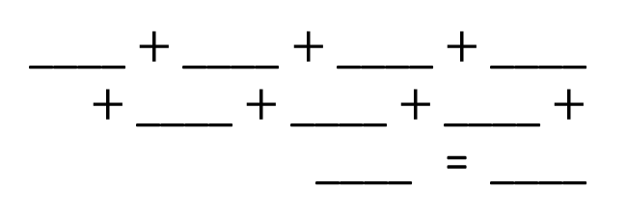
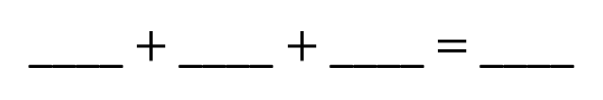
Your Turn
Write an addition sentence for 3 x 8
Write an addition sentence for 8 x 3
8
8
8
24
3
3
3
3
____ $+$ ____ $+$ ____ $=$ ____
____ $+$ ____ $+$ ____ $+$ ____ $+$ ____ $+$ ____ $+$ ____ $+$ ____ = ____
3
3
3
3
24
8 x 3 = 24
3 x 8 = 24
Draw this question: There are 3 crates. There are 8 apples in each crate. What times table does this represent?
3 $×$ 8

Slide 8

True or False
8 x 3 = 3 + 8
False

