Slide 1


Lesson 2:
12 x 7 table
www.arithmagicians.com

Slide 2

-7
-7
-7
-7
-7
-7
-7
-7
-7
7
14
21
28
35
42
49
56
63
70
Get ready to count back in 7s

Slide 3



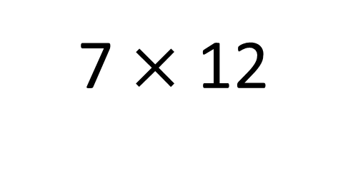
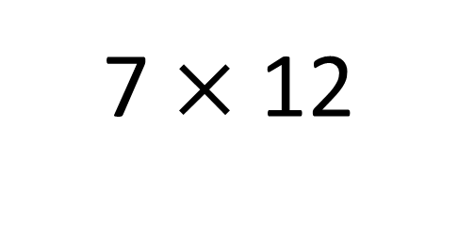
True
True or False
84
7 $×$ 12
=
7 $×$ 12
= 7 $×$ 10 + 7 x 2
7 x 10 + 7 x 2
=
70
14
7
___ groups of 12 is the same as 7 groups
of ____ plus 7 group of ___
10
2

Slide 4


Your Turn
Answer the questions below and be ready to explain which strategy you used.
35
5) 3 x 7 =
21
1) 7 x 5 =
2) 12 x 7 =
84
6) 6 x 7 =
42
3) 8 x 7 =
56
7) 7 x 12 =
84
4) 4 x 7 =
28
8) 7 x 11 =
77

Slide 5

True or False
7 x 12 = 7 x 10 + 7 + 7
True

