Slide 1


Lesson 2:
12 x 3 table
www.arithmagicians.com

Slide 2

-3
-3
-3
-3
-3
-3
-3
-3
-3
3
6
9
12
15
18
21
24
27
30
Get ready to count back in 3s

Slide 3





3
There are ____ groups.
3
12
There are ____ equal groups of ____
12
There are ____ in each group.
12
12
12
36
____ $+$ ____ $+$ ____ $=$ ____
36
There are ____ altogether.
36
____ $×$ ____ $=$ ____
3
12
3
12
36
____ $×$ ____ $=$ ____

Slide 4


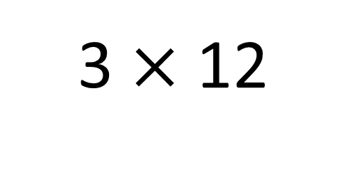
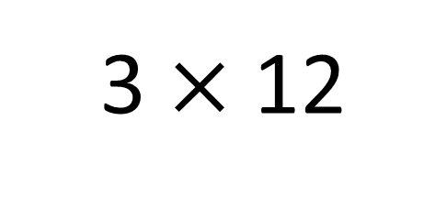
True
True or False
36
3 $×$ 12
=
3 $×$ 12
= 3 $×$ 10 + 3 x 2
3 x 10 + 3 x 2
=
30
6
3
___ groups of 12 is the same as 3 groups
of ____ plus 3 group of ___
10
2

Slide 5
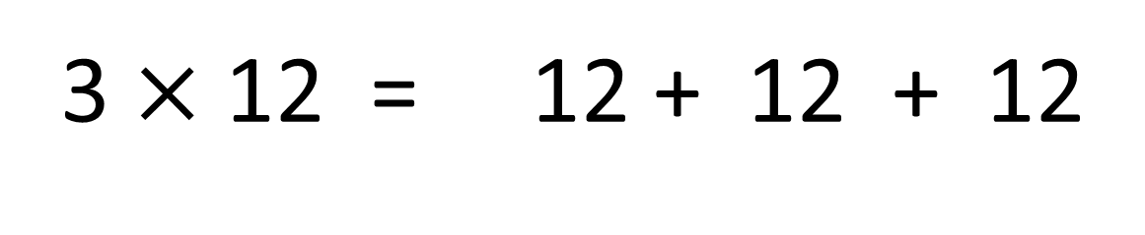
True
True or False
3 $×$ 12 = 12 + 12 + 12
=

Slide 6


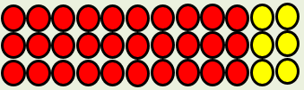
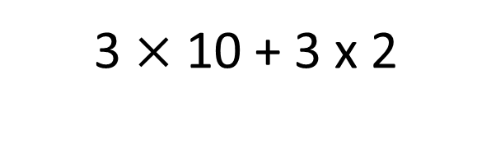
Solve: 12 x 3
Jasmin:
I am going to skip count in 12s, three times.
+12
+12
+12
0
12
24
36
Ben:
I will find 3 groups of 10, then add 3 group of 2.
3 $×$ 10 + 3 x 2
30 + 6
36
Which method do you prefer – why?

Slide 7


Your Turn
Answer the questions below and be ready to explain which strategy you used.
33
4) 7 x 3 =
21
1) 11 x 3 =
36
24
2) 3 x 12 =
5) 3 x 8 =
3) 3 x 9 =
27
6) 3 x 6 =
18

Slide 8

True or False
3 x 12 = 3 x 10 + 3 + 3
True

