Slide 1
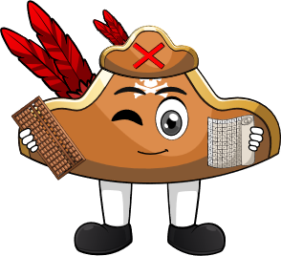

Assess & Review
www.arithmagicians.com

Slide 2

+10
+10
+10
+10
+10
+10
+10
+10
+10
10
20
30
40
50
60
70
80
90
100
Get ready to count up in 10s

Slide 3

What did we learn this week?
20
+
10
=
30
10
+
70
=
80
When you add 10 to a number, the tens digit goes up by _____.
one

Slide 4
What happens when you add
10 to a one-digit number?
10
+
4
=
14
6
+
10
=
16
What is the same?
What is different?

Slide 5


Your Turn
20
10 + 10 = ?
60
2) 10 + 50 = ?
18
3) 8 + 10 = ?
16
4) 10 + 6 = ?
5) 7 + 10 = ?
17

