Slide 1


Lesson 1:
Double, then
double again strategy
www.arithmagicians.com

Slide 2

+4
+4
+4
+4
+4
+4
+4
+4
+4
+4
0
4
8
12
16
20
24
28
32
36
40
Get ready to count up in 4s

Slide 3


True or False
Multiplying a number by 4 is the same as doubling and doubling again.
True:
Let’s see how we can prove it

Slide 4
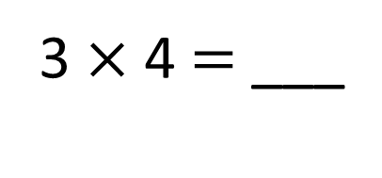
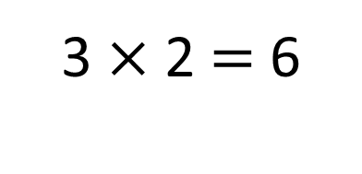
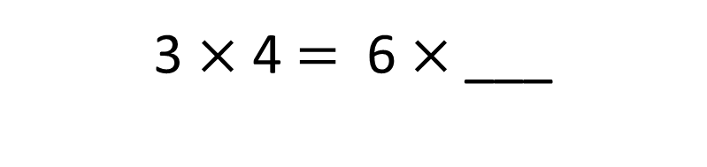
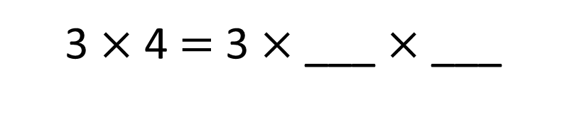
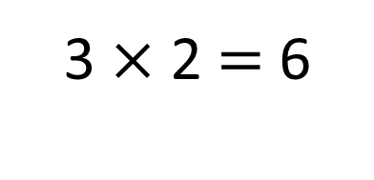
3 $×$ 2 $=$ 6
3 $×$ 2 $=$ 6
3
4
2
2
3 $×$ 4 $=$ 3 $×$ ___ $×$ ___
2
3 $×$ 4 $=$ 6 $×$___
12
3 $×$ 4 $=$ ___

Slide 5
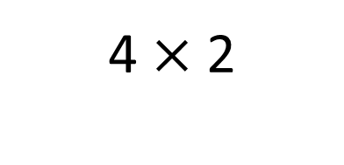
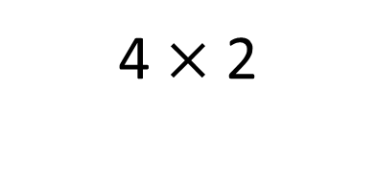
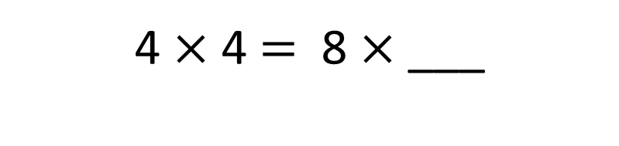
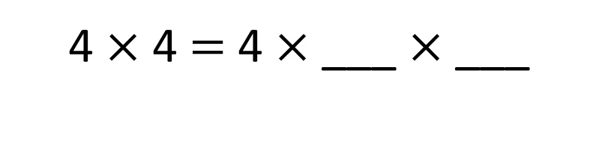
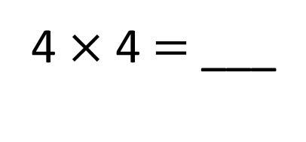
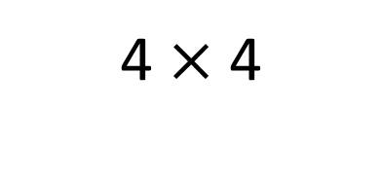
4 $×$ 2
4 $×$ 2
4 $×$ 4
+
=
8
8
16
2
2
4 $×$ 4 $=$ 4 $×$ ___ $×$ ___
2
4 $×$ 4 $=$ 8 $×$ ___
16
4 $×$ 4 $=$ ___

Slide 6


Your Turn
Answer the questions below using the
double, then double again strategy.
20
1) 5 x 4 = 5 x 2 x 2 = ___
28
2) 7 x 4 = 7 x 2 x 2 = ___
32
3) 8 x 4 = 8 x 2 x 2 = ___

Slide 7

True or False:
When you double a number twice, you are multiplying it by 4.
True

