Slide 1


Lesson 1:
Understanding Percentages
www.arithmagicians.com

Slide 2

Imagine we take this square and
split it into 100 equal parts.
If I shade 100 parts, I have 100%
There are now 100 equal parts
If I shade 26 parts, I have 26%
If I shade 99 parts, I have 99%
If I shade 1 part, I have 1%

Slide 3

Percent means parts out of 100
20
There are _______ parts out of a hundred shaded.
This is _______ %
20

Slide 4
Percent means parts out of 100
35
There are _______ parts out of a hundred shaded.
This is _______ %
35

Slide 5
Percent means parts out of 100
10
There are _______ parts out of a hundred shaded.
This is _______ %
10

Slide 6



True or False:
The image represents 1%

Slide 7
True or False:
The image represents 50%

Slide 8
True or False:
The image represents 50%

Slide 9
True or False:
The image represents 20%

Slide 10
True or False:
The image represents 20%

Slide 11
True or False:
The image represents 20%

Slide 12


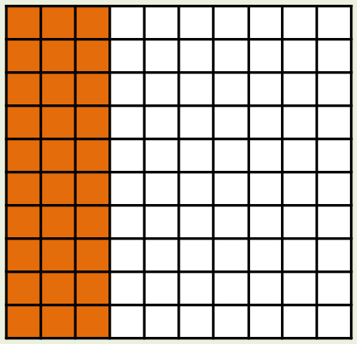
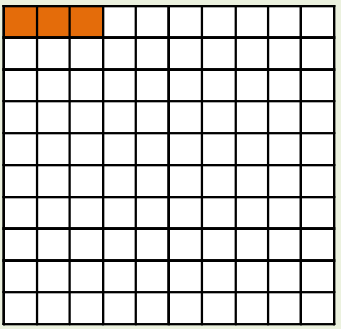
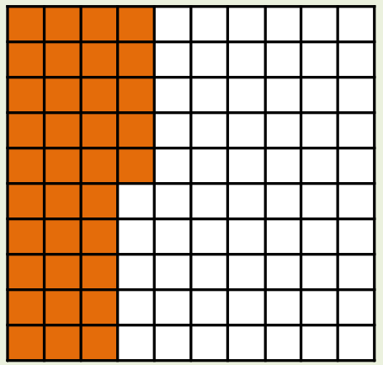
Your Turn
Match the image to the correct percentage
A
B
C
35%
30%
3%

Slide 13
True or False
Shading half of a
hundred square shows 25%.
False

