Slide 1


Lesson 2:
Double, then
double again strategy
www.arithmagicians.com

Slide 2

+4
+4
+4
+4
+4
+4
+4
+4
+4
+4
0
4
8
12
16
20
24
28
32
36
40
Get ready to count up in 4s

Slide 3

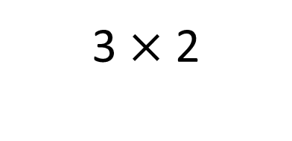
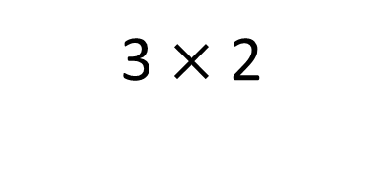
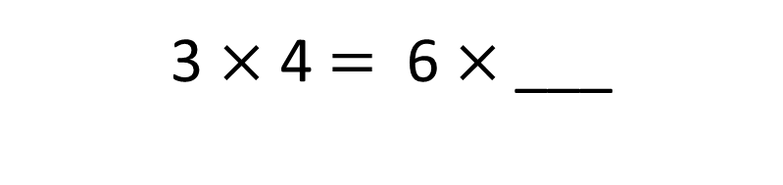
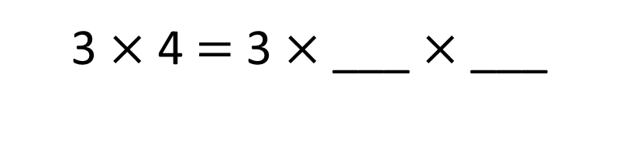
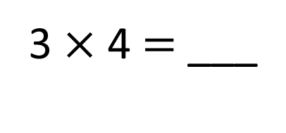
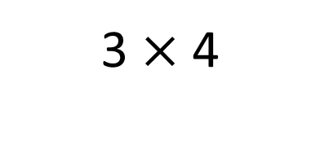
3 $×$ 2
3 $×$ 2
3 $×$ 4
+
=
6
6
12
2
2
3 $×$ 4 $=$ 3 $×$ ___ $×$ ___
2
3 $×$ 4 $=$ 6 $×$___
12
3 $×$ 4 $=$ ___

Slide 4

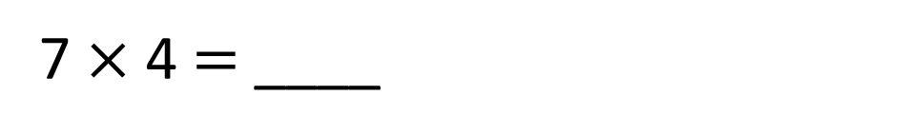
To multiply by 4, take the number you are multiplying and double it twice.
28
7 $×$ 4 $=$ ____
7
double
14
28
double
7
14
14
28
Double ____ is ____ and double ____ is ____ , so 4 lots of ____ is ____
7
28

Slide 5


Your Turn
6 x 4 =
6
double
12
double
24
8 x 4 =
8
double
16
double
32
5 x 4 =
5
double
10
double
20
12 x 4 =
12
double
24
double
48

