Slide 1
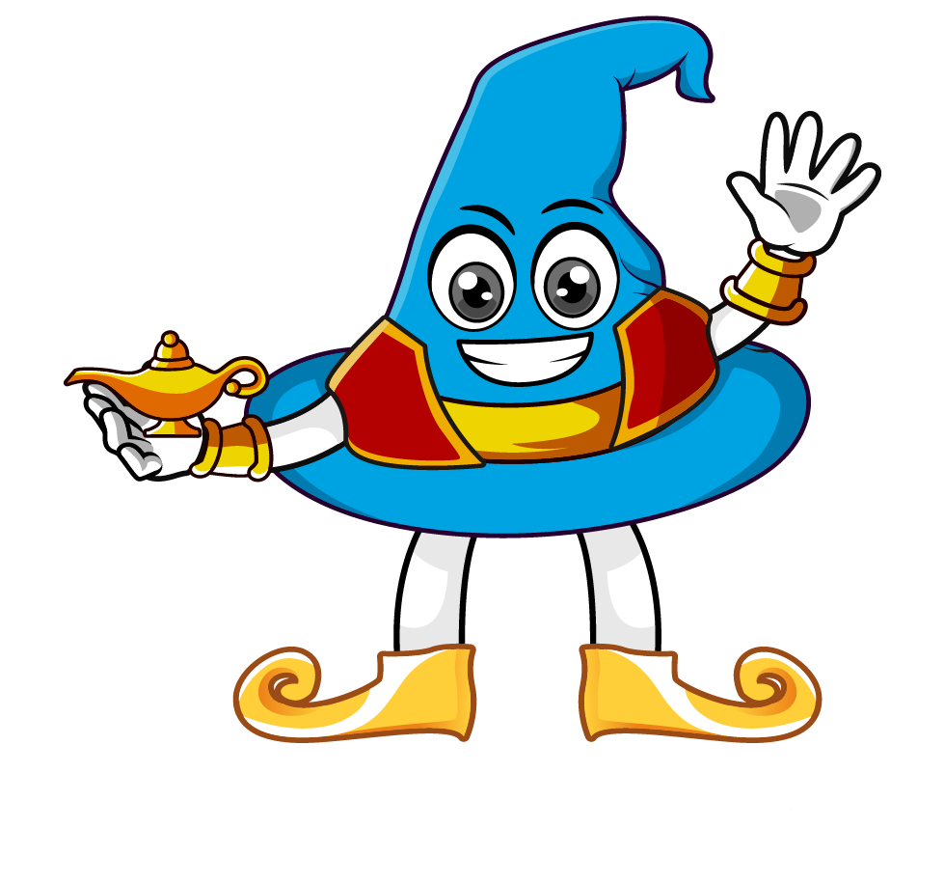

Lesson 3:
Percentage of
an amount: 1%
www.arithmagicians.com

Slide 2

What percent of the shape is blue?
1%

Slide 3
1% of 100 =
1
1
1
1
1
1
1
1
1
1
1
1
1
1
1
1
1
1
1
1
1
1
1
1
1
1
1
1
1
1
1
1
1
1
1
1
1
1
1
1
1
1
1
1
1
1
1
1
1
1
1
1
1
1
1
1
1
1
1
1
1
1
1
1
1
1
1
1
1
1
1
1
1
1
1
1
1
1
1
1
1
1
1
1
1
1
1
1
1
1
1
1
1
1
1
1
1
1
1
1
1
100

Slide 4

2
1% of 200 =
2
2
2
2
2
2
2
2
2
2
2
2
2
2
2
2
2
2
2
2
2
2
2
2
2
2
2
2
2
2
2
2
2
2
2
2
2
2
2
2
2
2
2
2
2
2
2
2
2
2
2
2
2
2
2
2
2
2
2
2
2
2
2
2
2
2
2
2
2
2
2
2
2
2
2
2
2
2
2
2
2
2
2
2
2
2
2
2
2
2
2
2
2
2
2
2
2
2
2
2
200

Slide 5
4
1% of 400 =
4
4
4
4
4
4
4
4
4
4
4
4
4
4
4
4
4
4
4
4
4
4
4
4
4
4
4
4
4
4
4
4
4
4
4
4
4
4
4
4
4
4
4
4
4
4
4
4
4
4
4
4
4
4
4
4
4
4
4
4
4
4
4
4
4
4
4
4
4
4
4
4
4
4
4
4
4
4
4
4
4
4
4
4
4
4
4
4
4
4
4
4
4
4
4
4
4
4
4
4
400

Slide 6
What do you notice?
1% of 100 = 1
1% of 200 = 2
1% of 400 = 4
To calculate 1% of a number,
you divide the number by ___
100

Slide 7


Your Turn
1) 1% of 1000 =
10
5) 10% of 600 =
60
2) 1% of 500 =
5
6) 1% of 600 =
6
3) 1% of 700 =
7
7) 10% of 800 =
80
4) 1% of 300 =
3
8
8) 1% of 800 =

Slide 8

True or False
1% of a number is the same as 1/100 of a number.
True: can you explain why

