Slide 1

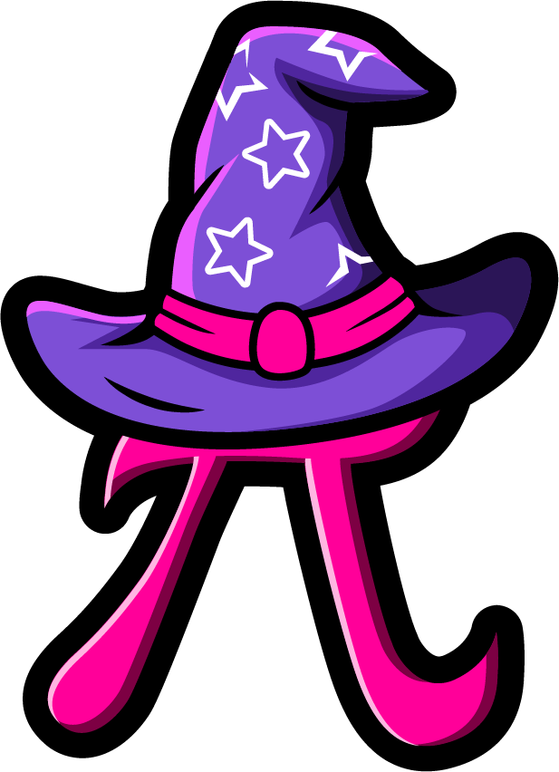
Lesson 3:
Subtracting a number
from itself
www.arithmagicians.com

Slide 2


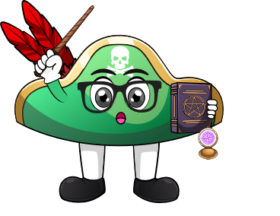
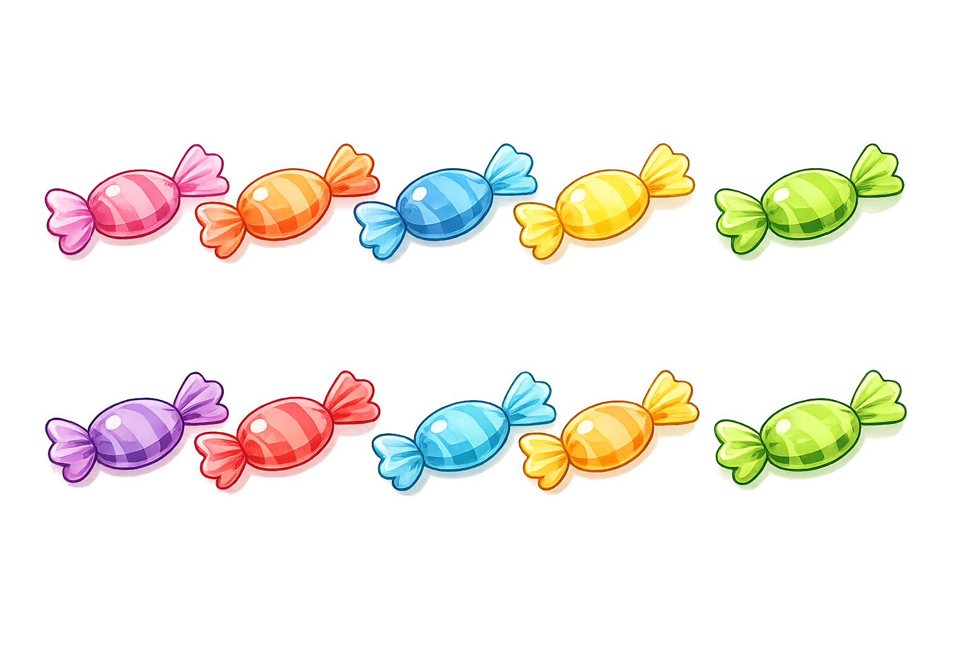

How many sweets do I have left?
I eat all 10 sweets
I have 10 sweets
Zero sweets left

Slide 3


I take away 3 cookies
How many cookies do I have left?
I have 3 cookies
I have 3 cookies
3 - 3
= 0

Slide 4

5
-
5
=
0

Slide 5

What do you notice?
5
-
5
=
0
10
-
10
=
0
same
When we subtract the ______
number, the answer is always ____.
0

Slide 6


Your Turn
0
6 - 6 = ?
0
2) 3 - 3 = ?
0
3) 8 - 8 = ?
4) 4 - ? = 0
4
5) 100 - 100 = ?
0

Slide 7
Always, Sometimes or Never
When we subtract the same number, the answer is 0
Always

