Slide 1


Lesson 4:
Understanding Tenths As Percentages
www.arithmagicians.com

Slide 2

Imagine we take this square and
split it into 100 equal parts.
If I shade 100 parts, I have 100%
There are now 100 equal parts
If I shade 20 parts, I have 20%
If I shade 10 parts, I have 10%

Slide 3

What’s the same and what’s different?
10
____ % is the same as one tenth.
___% =
1/10
10

Slide 4
What’s the same and what’s different?
30
____ % is the same as three tenth.
___% =
3/10
30

Slide 5
What’s the same and what’s different?
70
____ % is the same as seven tenth.
___% =
7/10
70

Slide 6
What’s the same and what’s different?
50
____ % is the same as five tenth.
___% =
5/10
50

Slide 7


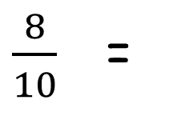
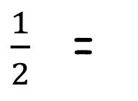
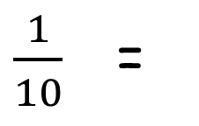
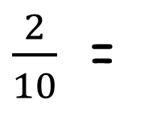
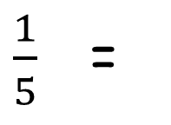
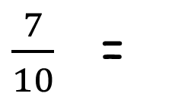
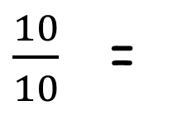
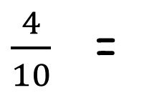
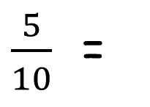
Your Turn
Convert the following fractions into percentages.
$\frac{4}{10}$ =
40%
$\frac{5}{10}$ =
50%
$\frac{8}{10}$ =
80%
$\frac{1}{2}$ =
50%
$\frac{1}{10}$ =
10%
$\frac{2}{10}$ =
20%
$\frac{7}{10}$ =
70%
$\frac{1}{5}$ =
20%
$\frac{10}{10}$ =
100%
1 =
100%

Slide 8


True or False
20% = $\frac{20}{100}$ = $\frac{2}{10}$ = $\frac{1}{5}$
True

