Slide 1
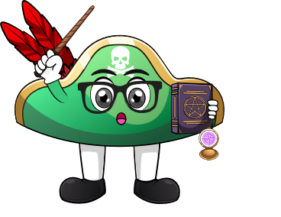

Lesson 4:
Subtracting a number
from itself
www.arithmagicians.com

Slide 2

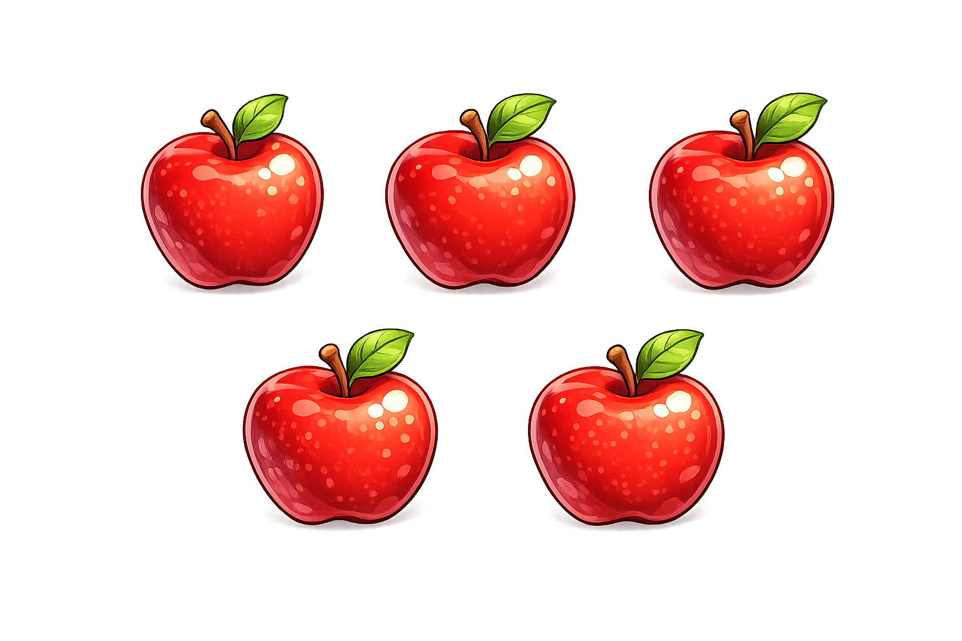

How many apples do I have left?
I have 5 apples
I eat all 5 apples
Zero apples left

Slide 3



How many burgers do I have left?
I take away 4 burgers
I have 4 burgers
4 - 4
= 0

Slide 4

7
-
7
=
0

Slide 5

What do you notice?
4
-
4
=
0
7
-
7
=
0
same
When we subtract the ______
number, the answer is always ____.
0

Slide 6


Your Turn
0
8 - 8 = ?
0
2) 5 - 5 = ?
0
3) 3 - 3 = ?
4) 7 - ? = 0
7
0
5) 50 - 50 = ?

Slide 7
True or False
When we subtract the same number, there is something left.
False

