Slide 1


Lesson 5:
Assess and Review
www.arithmagicians.com

Slide 2

+4
+4
+4
+4
+4
+4
+4
+4
+4
+4
0
4
8
12
16
20
24
28
32
36
40
Get ready to count up in 4s

Slide 3

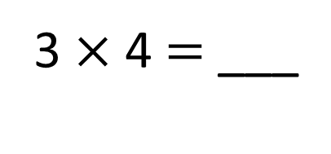
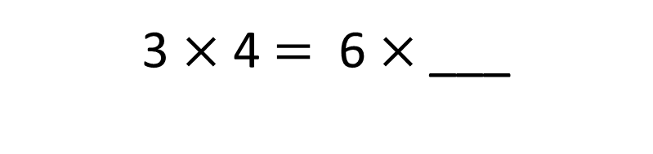
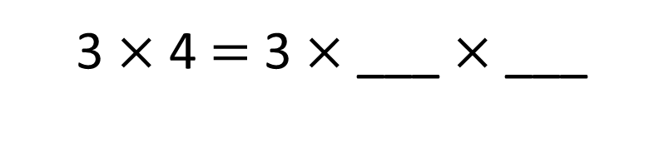
3 $×$ 2 $=$ 6
3 $×$ 2 $=$ 6
3
4
2
2
3 $×$ 4 $=$ 3 $×$ ___ $×$ ___
2
3 $×$ 4 $=$ 6 $×$___
12
3 $×$ 4 $=$ ___

Slide 4
4 $×$ 2
4 $×$ 2
4 $×$ 4
+
=
8
8
16
2
2
4 $×$ 4 $=$ 4 $×$ ___ $×$ ___
2
4 $×$ 4 $=$ 8 $×$ ___
16
4 $×$ 4 $=$ ___

Slide 5

To multiply by 4, take the number you are multiplying and double it twice.
28
7 $×$ 4 $=$ ____
7
double
14
28
double
7
14
14
28
Double ____ is ____ and double ____ is ____ , so 4 lots of ____ is ____
7
28

Slide 6


Your Turn
1) 2 x 4 =
8
6) 4 x 4 =
16
2) 4 x 1 =
4
7) 4 x 6 =
24
3) 5 x 4 =
20
8) 0 x 4 =
0
4) 3 x 4 =
12
9) 4 x 7 =
28
5) 4 x 9 =
36
10) 8 x 4 =
32

