Slide 1


Lesson 5:
Assess and Review
www.arithmagicians.com

Slide 2

Imagine we take this square and
split it into 100 equal parts.
If I shade 100 parts, I have 100%
There are now 100 equal parts
If I shade 26 parts, I have 26%
If I shade 99 parts, I have 99%
If I shade 1 part, I have 1%

Slide 3

Percent means parts out of 100
35
There are _______ parts out of a hundred shaded.
This is _______ %
35

Slide 4
Percent means parts out of 100
10
There are _______ parts out of a hundred shaded.
This is _______ %
10

Slide 5
What’s the same and what’s different?
25
____ % is the same as one quarter.
___% =
1/4
25

Slide 6
What’s the same and what’s different?
75
____ % is the same as three quarter.
___% =
3/4
75

Slide 7
What’s the same and what’s different?
20
____ % is the same as one fifth.
___% =
1/5
20

Slide 8
What’s the same and what’s different?
70
____ % is the same as seven tenth.
___% =
7/10
70

Slide 9
What’s the same and what’s different?
50
____ % is the same as five tenth.
___% =
5/10
50

Slide 10


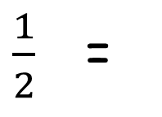
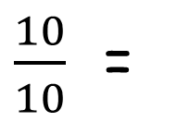
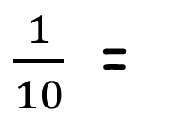
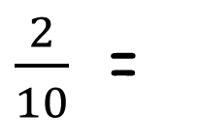
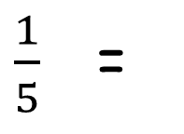
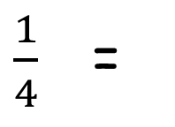
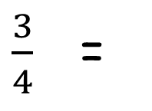
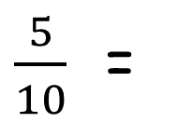
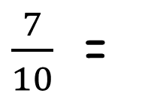
Your Turn
Convert the following fractions into percentages.
$\frac{5}{10}$ =
50%
1 =
100%
$\frac{1}{2}$ =
50%
$\frac{10}{10}$ =
100%
$\frac{1}{10}$ =
10%
$\frac{2}{10}$ =
20%
$\frac{1}{4}$ =
25%
$\frac{1}{5}$ =
20%
$\frac{3}{4}$ =
75%
$\frac{7}{10}$ =
70%

