Slide 1


Lesson 1:
Introducing the
multiplication symbol
www.arithmagicians.com

Slide 2

-2
-2
-2
-2
-2
-2
-2
-2
-2
2
4
6
8
10
12
14
16
18
20
Get ready to count back in 2s

Slide 3




3
There are equal groups with
in each group.
$+$ $+$ $=$ 12
4
4
4
4
$×$ $=$ 12
3
4

Slide 4
What does the symbol × mean?
Come up with different definitions?
“lots of”
“groups of”
“times”

Slide 5
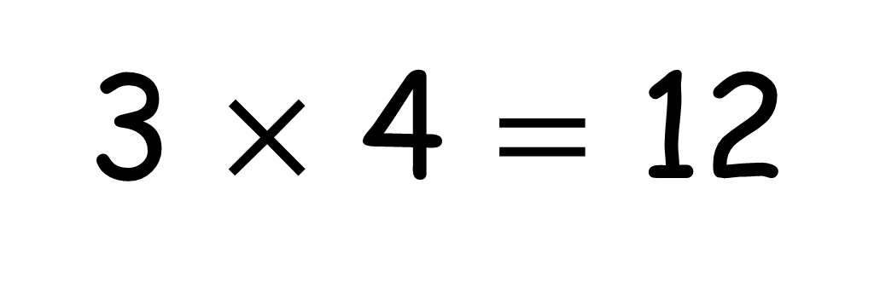
3 $×$ 4 $=$ 12
“3 lots of 4 is equal to 12”
“3 groups of 4 is equal to 12”
“3 times 4 is equal to 12”

Slide 6


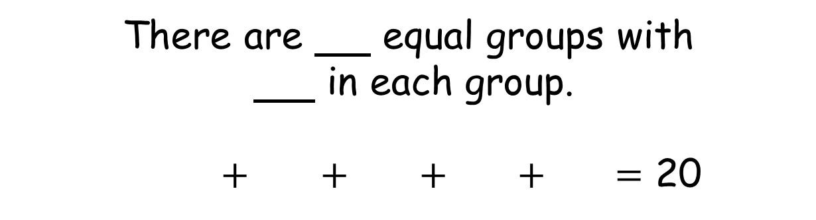

5
There are equal groups with
in each group.
$+$ $+$ $+$ $+$ $=$ 20
4
4
4
4
4
4
$×$ $=$ 20
5
4

Slide 7





Your Turn
Draw a picture
to match the calculation.
3 x 4
2 x 5
4 x 3

Slide 8
True of False
3 x 4
=
4 x 3
=
True
What’s the same and what’s different?

