Slide 1


Lesson 1:
x4 Table
(Focus 6 x 4)
www.arithmagicians.com

Slide 2

+4
+4
+4
+4
+4
+4
+4
+4
+4
+4
0
4
8
12
16
20
24
28
32
36
40
Get ready to count up in 4s

Slide 3



6
There are ____ groups.
4
There are ____ in each group.
24
There are ____ altogether.
24
____ $×$ ____ $=$ ____
6
4

Slide 4

4
There are ____ groups.
6
There are ____ in each group.
24
There are ____ altogether.
24
____ $×$ ____ $=$ ____
4
6

Slide 5

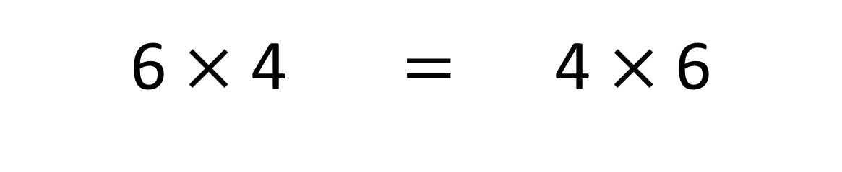
True
True or False
6 $×$ 4 $=$ 4 $×$ 6

Slide 6


Solve: 6 x 4
Ben:
I am going to skip count in 6s, four times.
+6
+6
+6
+6
0
6
12
18
24
Amy:
I am going to use the double, then double again strategy.
6
double
12
double
24
Which method do you prefer – why?

Slide 7


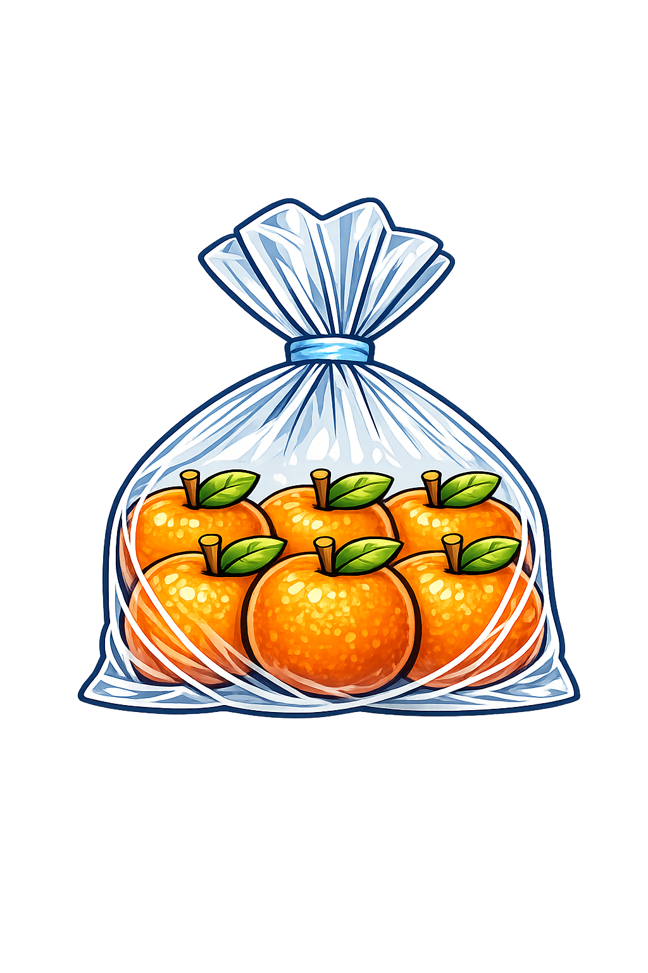
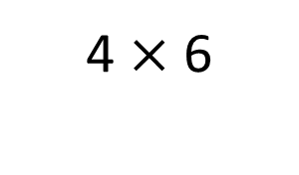
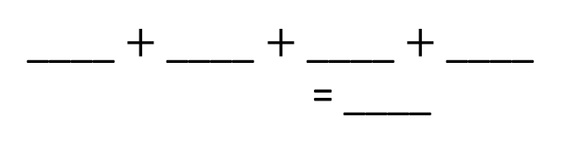
Your Turn
There are 6 bags of bananas. Each bag contains 4 bananas.
How many bananas are there altogether?
Write an addition sentence for 4 x 6
6
6
6
6
____ $+$ ____ $+$ ____ $+$ ____
= ____
6 x 4 = 24
24
6 x 4 = 24
4 x 6 = 24
Draw this question: There are 4 bags of oranges. There are 6 oranges in each bag. What times table does this represent?
4 $×$ 6

Slide 8

True or False
6 × 4 = 7 × 4 − 4
True

