Slide 1
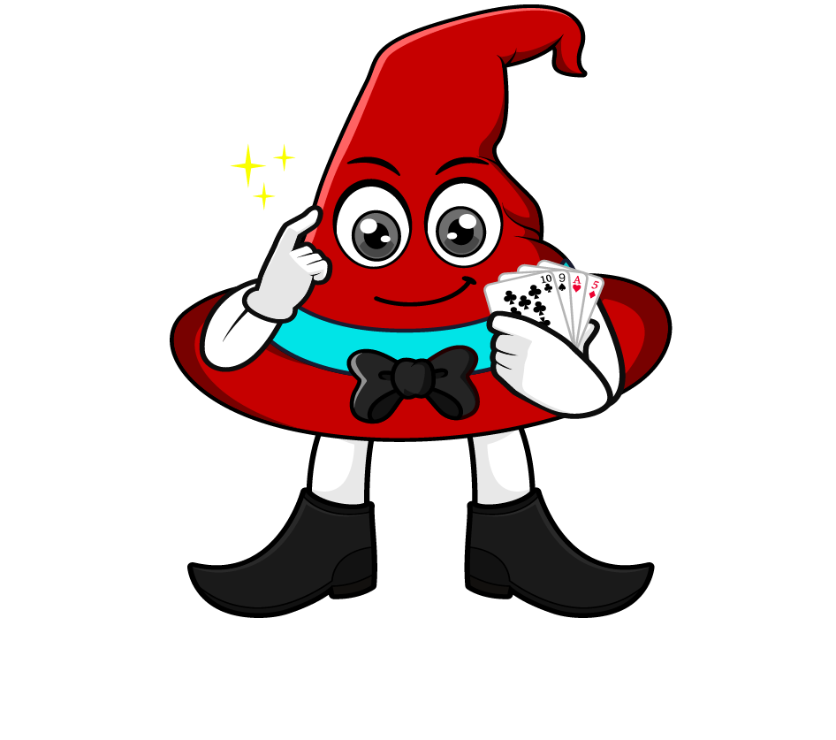

Lesson 1:
Understanding Hundredths As Percentages
www.arithmagicians.com

Slide 2

Imagine we take this square and
split it into 100 equal parts.
If I shade 100 parts, I have 100%
There are now 100 equal parts
If I shade 26 parts, I have 26%
If I shade 99 parts, I have 99%
If I shade 1 part, I have 1%

Slide 3

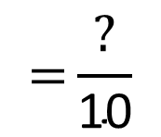
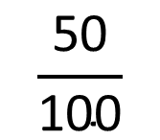


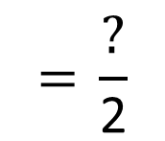
50 out of 100 squares are shaded.
5
1
$$\frac{\text{50}}{\text{100}}$$
$$\text{=}\frac{\text{?}}{\text{10}}$$
$$\text{=} \frac{\text{?}}{\text{2}}$$
50
$$\text{=}$$
$$\text{?} \text{\%}$$

Slide 4

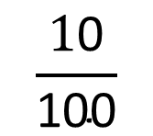
10 out of 100 squares are shaded.
1
$$\frac{\text{1}\text{0}}{\text{100}}$$
$$\text{=}\frac{\text{?}}{\text{10}}$$
10
$$\text{ =}$$
$$\text{?} \text{\%}$$

Slide 5

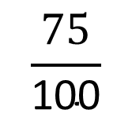
75 out of 100 squares are shaded.
3
$$\frac{\text{75}}{\text{100}}$$
$$\text{=} \frac{\text{?}}{\text{4}}$$
75
$$\text{ =}$$
$$\text{?} \text{\%}$$

Slide 6
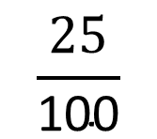
25 out of 100 squares are shaded.
1
$$\frac{\text{25}}{\text{100}}$$
$$\text{= }\frac{\text{?}}{\text{4}}$$
25
$$\text{ =}$$
$$\text{?} \text{\%}$$

Slide 7
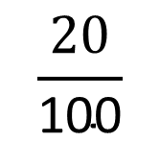

20 out of 100 squares are shaded.
2
1
$$\frac{\text{20}}{\text{100}}$$
$$\text{=}\frac{\text{?}}{\text{10}}$$
$$\text{=} \frac{\text{?}}{\text{5}}$$
20
$$\text{=}$$
$$\text{?} \text{\%}$$

Slide 8

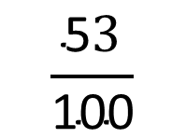
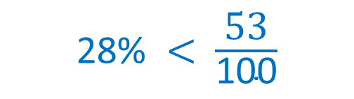
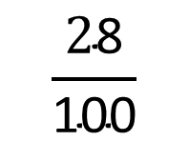
Which is greater 28% or $\frac{\text{53}}{\text{100}}$?
28 out of 100
$$\frac{\text{2}\text{8}}{\text{100}}$$
28%
53 out of 100
$$\frac{\text{5}3}{\text{100}}$$
53%
28% $<$ $\frac{\text{53}}{\text{100}}$

Slide 9






Your Turn
Which is the greater amount?
1) 57% or $\frac{\text{39}}{\text{100}}$
2) 21% or $\frac{\text{44}}{\text{100}}$
3) 100% or $\frac{\text{99}}{\text{100}}$
4) 9% or $\frac{\text{5}}{\text{100}}$

Slide 10


True or False
$\frac{20}{100}$ > 20%
False: Can you explain why?

