Slide 1


Lesson 2:
Using Arrays
www.arithmagicians.com

Slide 2


-2
-2
-2
-2
-2
-2
-2
-2
-2
2
4
6
8
10
12
14
16
18
20
Get ready to count back in 2s

Slide 3


Which counters are easier to count? Why?
9
9

Slide 4
An array is made up of equal rows and columns
columns
rows

Slide 5


True or False:
The diagram shows an array?

Slide 6
True or False:
The diagram shows an array?

Slide 7
True or False:
The diagram shows an array?
Can you
explain why?

Slide 8

Complete the number sentences to match the array.
$+$ $+$ $=$
6
6
6
18
$×$ $=$
3
6
18

Slide 9


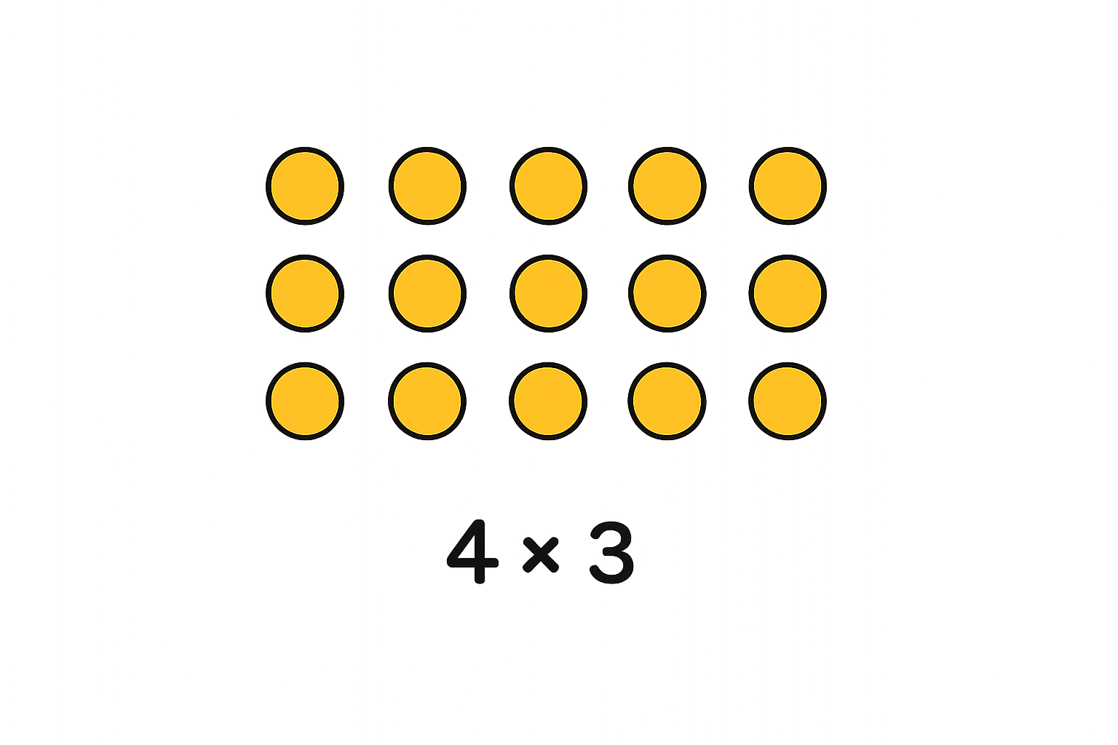
Your Turn
Draw an array to show:
3 + 3 + 3 + 3
3 x 4
What do you notice?
What’s the same and what’s different?

Slide 10

True or False
The image
shows an array?
False

