Slide 1


Lesson 2:
x4 Table
(Focus 7 x 4)
www.arithmagicians.com

Slide 2

-4
-4
-4
-4
-4
-4
-4
-4
-4
4
8
12
16
20
24
28
32
36
40
Get ready to count back in 4s

Slide 3

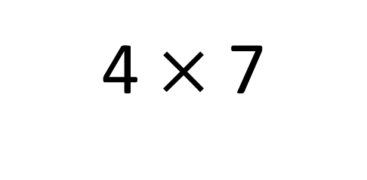
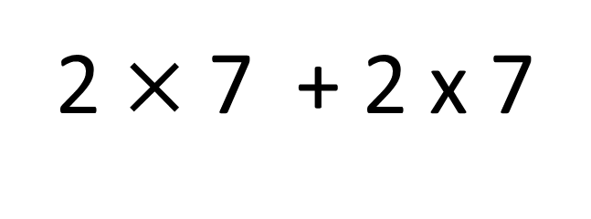
True
True or False
4 $×$ 7
=
2 $×$ 7 + 2 x 7
=
28
=
14 + 14

Slide 4


Solve: 7 x 4
Ben:
I am going to skip count in 7s, four times.
+7
+7
+7
+7
0
7
14
21
28
Amy:
I am going to use the double, then double again strategy.
7
double
14
double
28
Which method do you prefer – why?

Slide 5


Your Turn
Complete Bar Model
A class lines up in 7 rows of 4 pupils.
How many pupils are there?
28
7 | 7 | 7 | 7
28
? | ? | ? | ?
7 x 4 = 28
7 x 4 = 28
4 x 7 = 28
Draw this question using bar model:
There are 7 bags of oranges.
There are 4 oranges in each bag.
What times table does this represent?
28
4 | 4 | 4 | 4 | 4 | 4 | 4
7 x 4 = 28

Slide 6

True or False
7 × 4 = 7 + 4
False

