Slide 1


Lesson 2:
Percentage of an amount: 20%
www.arithmagicians.com

Slide 2

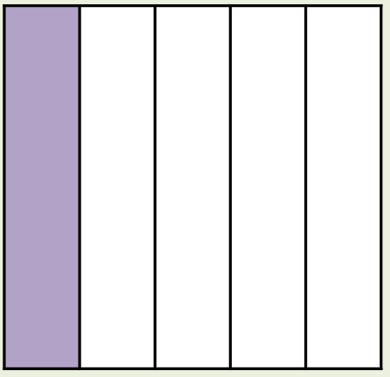
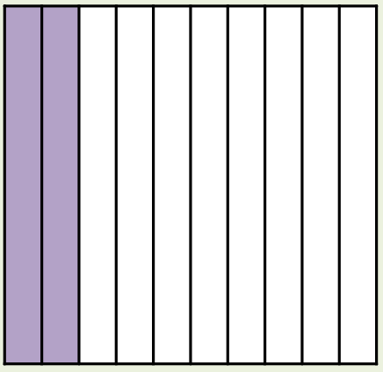
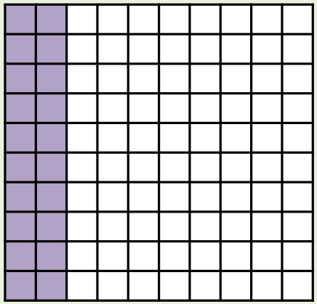
What’s the same and what’s different?
Fraction
Decimal
Percentage
1/5
0.2
20%
_____
_____
_____

Slide 3
1/5
What fraction of the bar is shaded?
20%
What percentage of the bar is shaded?

Slide 4


20% of 200
2
2
2
2
2
2
2
2
2
2
Amy:
First, I will calculate 10%.
2
2
2
2
2
2
2
2
2
2
Next, I will multiply
20 by 2
2
2
2
2
2
2
2
2
2
2
10% = 20
20% = 40
20% of 200 = 40
2
2
2
2
2
2
2
2
2
2
10% of 200 = 20
2
2
2
2
2
2
2
2
2
2
x2
2
2
2
2
2
2
2
2
2
2
2
2
2
2
2
2
2
2
2
2
2
2
2
2
2
2
2
2
2
2
2
2
2
2
2
2
2
2
2
2
2
2
2
2
2
2
2
2
2
2
200

Slide 5

Find 20% of 250
Amy:
I am going to find 10% and then double it.
+6
+6
+6
0
6
12
18
Ben:
I am going to find 1/5 of 250 by dividing it by 5.
+3
+3
+3
+3
+3
+3
0
3
6
9
12
15
18
Which method do you prefer – why?

Slide 6


Your Turn
1) 10% of 400 =
40
5) 25% of 300 =
75
2) 20% of 400 =
80
6) 10% of 700 =
70
3) 10% of 500 =
50
7) 1% of 700 =
7
4) 20% of 500 =
100
140
8) 20% of 700 =

Slide 7

True or False
20% of a number is the same
as 1/10 of a number
multiplied by 2
True: Can you explain why?

