Slide 1


Lesson 3:
Ordering
Percentages & Fractions
www.arithmagicians.com

Slide 2


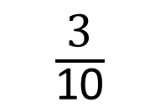
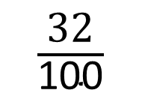
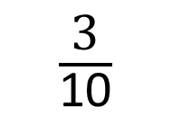
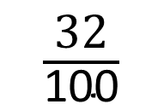
Put the following numbers in ascending order.
First, I will convert the fractions into percentages
Finally, I will write out the new order.
Next, I will order the percentages from the smallest to the largest.
$\frac{\text{32}}{\text{100}}$
35%
$\frac{\text{3}}{\text{10}}$
43%
32%
35%
30%
43%
$\frac{\text{3}}{\text{10}}$
$\frac{\text{32}}{\text{100}}$
35%
43%

Slide 3

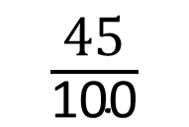
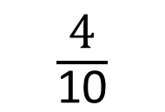
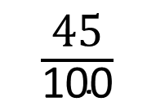
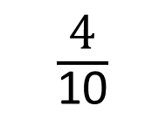
Put the following numbers in ascending order.
First, convert fractions to percentages.
Next, order the percentages from smallest to largest.
Finally, write out the new order correctly.
$\frac{\text{4}}{\text{10}}$
48%
$\frac{\text{45}}{\text{100}}$
43%
40%
48%
45%
43%
$\frac{\text{4}}{\text{10}}$
43%
$\frac{\text{45}}{\text{100}}$
48%

Slide 4


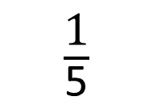
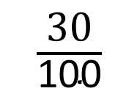
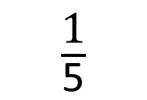
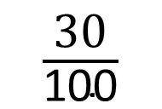
Your Turn
Put the following numbers in
ascending order.
First, convert fractions to percentages.
Next, order the percentages from smallest to largest.
Finally, write out the new order correctly.
$\frac{\text{1}}{\text{5}}$
55%
$\frac{\text{30}}{\text{100}}$
25%
20%
55%
30%
25%
$\frac{\text{1}}{\text{5}}$
25%
$\frac{\text{30}}{\text{100}}$
55%

Slide 5
True or False
40/100 = 4/10 = 40%
True

