Slide 1


Lesson 4:
Commutative property of multiplication
www.arithmagicians.com

Slide 2


-2
-2
-2
-2
-2
-2
-2
-2
-2
2
4
6
8
10
12
14
16
18
20
Get ready to count back in 2s

Slide 3


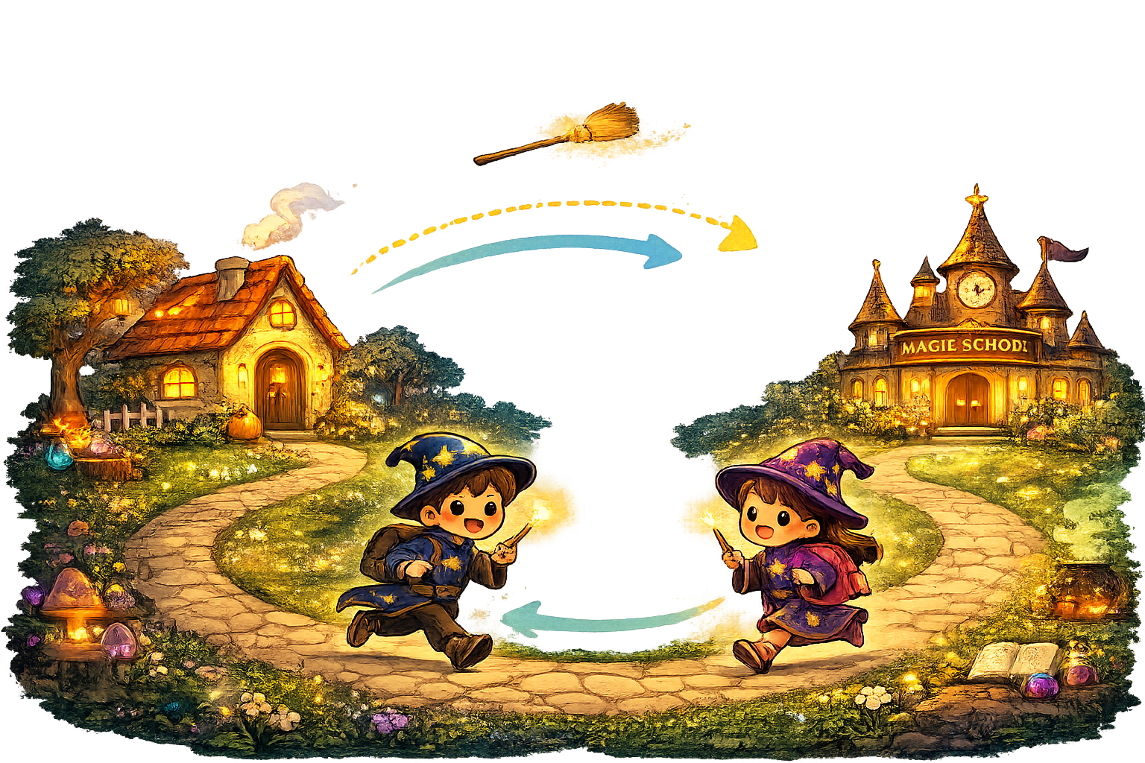
To commute means to travel back and forth. You can go to school and back home – but it’s still the same journey.
Who commutes
to school?

Slide 4

Let’s look at an example:
Complete the number sentences to match the array.
$+$ $+$ $=$
5
5
5
15
$×$ $=$
3
5
15

Slide 5
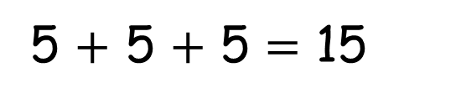



How can you write the number sentences another way?
5 $+$ 5 $+$ 5 $=$ 15
3 $×$ 5 $=$ 15
3 $+$ 3 $+$ 3 $+$ 3 $+$ 3 $=$ 15
5 $×$ 3 $=$ 15

Slide 6
True
True or False
8 $×$ 3 $=$ 3 $×$ 8

Slide 7


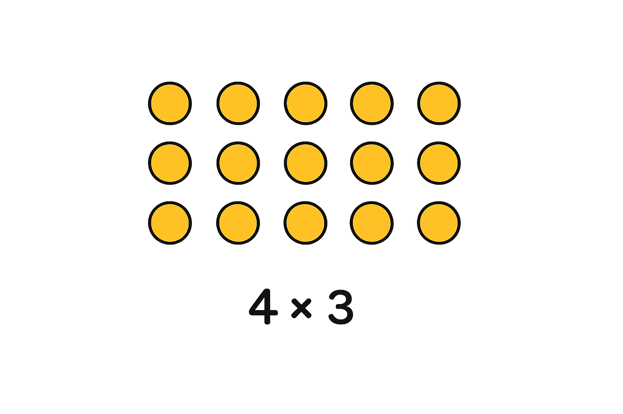
Your Turn
Draw an array to show:
5 x 4
4 x 5
What do you notice?
What’s the same and what’s different?

Slide 8
True or False
6 x 2 = 2 x 6
True

