Slide 1
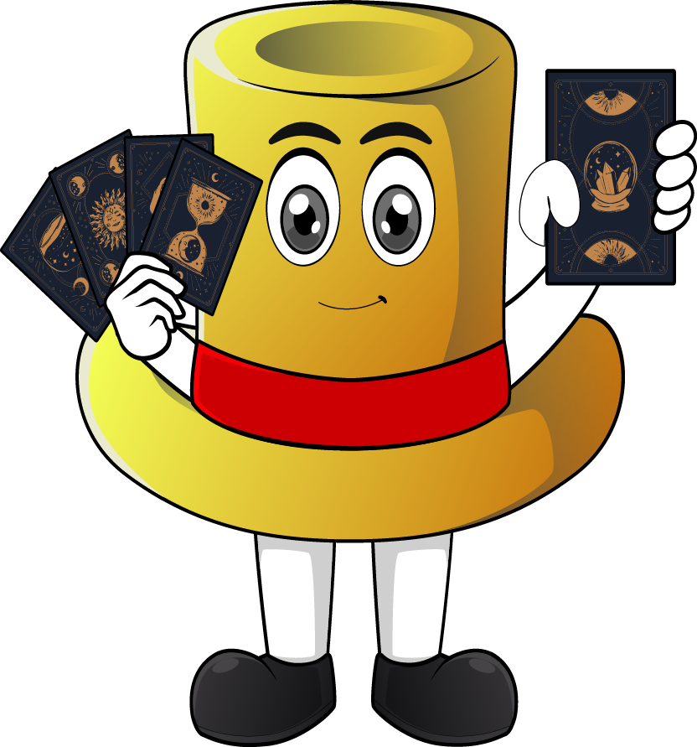

Lesson 4:
x4 Table
(Focus 9 x 4)
www.arithmagicians.com

Slide 2

-4
-4
-4
-4
-4
-4
-4
-4
-4
4
8
12
16
20
24
28
32
36
40
Get ready to count back in 4s

Slide 3



9
There are ____ groups.
4
There are ____ in each group.
36
There are ____ altogether.
36
____ $×$ ____ $=$ ____
9
4

Slide 4


4
There are ____ groups.
9
There are ____ in each group.
36
There are ____ altogether.
36
____ $×$ ____ $=$ ____
4
9

Slide 5


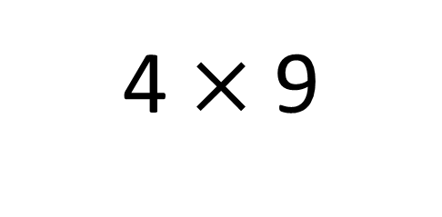
True
True or False
4 $×$ 9
=
4 $×$ 10 - 4 x 1
=
4
___ groups of 9 is the same as 4 groups
of ____ minus one group of ___
10
4

Slide 6


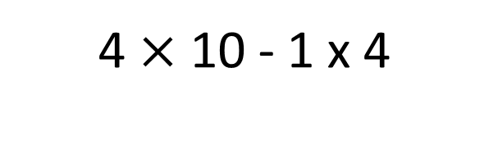
Solve: 9 x 4
Jasmin:
I am going to skip count in 9s, four times.
+9
+9
+9
+9
0
9
18
27
36
Amy:
I will find 4 groups of 10, then subtract 1 group of 4.
4 $×$ 10 - 1 x 4
40 - 4
36
Which method do you prefer – why?

Slide 7


Your Turn
Answer the questions below and be ready to explain which strategy you used.
12
4) 9 x 4 =
36
1) 3 x 4 =
32
28
2) 8 x 4 =
5) 7 x 4 =
3) 4 x 6 =
24
6) 4 x 4 =
16

Slide 8

True or False
4 x 9 = 9 x 2 x 2
True

