Slide 1


Lesson 4:
Ordering
Percentages & Fractions
www.arithmagicians.com

Slide 2


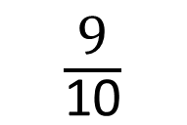
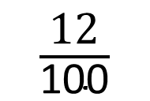
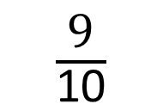
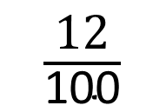
Put the following numbers in descending order.
First, I will convert the fractions into percentages
Next, I will order the percentages from the largest to the smallest.
Finally, I will write out the new order.
$\frac{\text{12}}{\text{100}}$
27%
$\frac{\text{9}}{\text{10}}$
45%
12%
27%
90%
45%
$\frac{\text{9}}{\text{10}}$
45%
27%
$\frac{\text{12}}{\text{100}}$

Slide 3

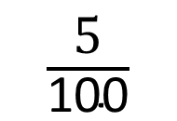
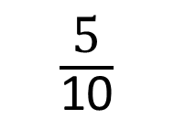
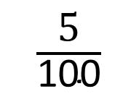
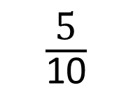
Put the following numbers in descending order.
First, convert fractions to percentages.
Next, order the percentages from largest to smallest.
Finally, write out the new order correctly.
$\frac{\text{5}}{\text{10}}$
46%
$\frac{\text{5}}{\text{100}}$
55%
50%
46%
5%
55%
55%
$\frac{\text{5}}{\text{10}}$
46%
$\frac{\text{5}}{\text{100}}$

Slide 4


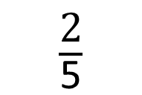
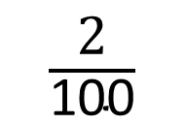
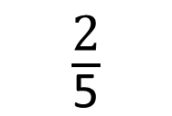
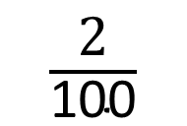
Your Turn
Put the following numbers in
descending order.
First, convert fractions to percentages.
Next, order the percentages from largest to smallest.
Finally, write out the new order correctly.
$\frac{\text{2}}{\text{5}}$
20%
$\frac{\text{2}}{\text{100}}$
75%
40%
20%
2%
75%
75%
$\frac{\text{2}}{\text{5}}$
20%
$\frac{\text{2}}{\text{100}}$

Slide 5

True or False
$\frac{3}{100}$ = 30%
False: Can you explain why?

