Slide 1
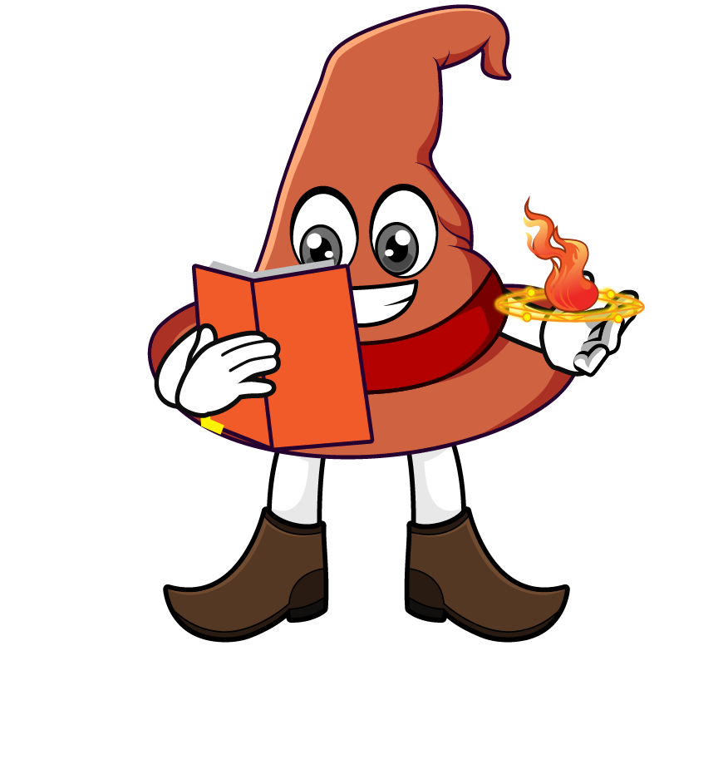

Lesson 4:
Percentage of an
amount: 99%
www.arithmagicians.com

Slide 2

What percent of the shape is blue?
99%

Slide 3


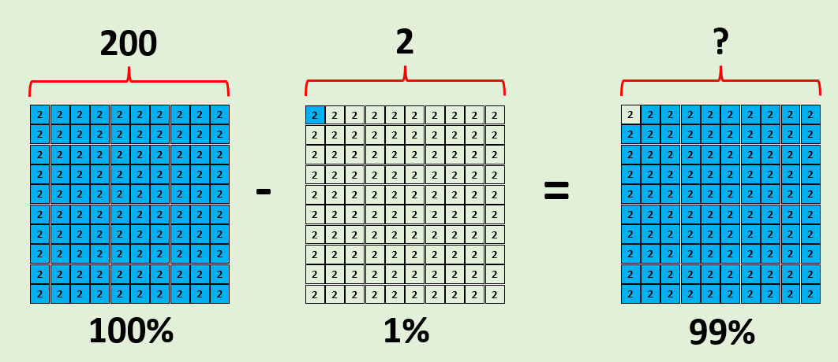
99% of 200
Jasmine
First, I will calculate 100% and 1% of 200
I know that:
100% – 1% = 99%
200 – 2 = 198
So, 99% of 200 = 198
100% = 200
1% = 2
198

Slide 4

99% of 200
2
2
2
2
2
2
2
2
2
2
Amy:
First, I will calculate 10%.
2
2
2
2
2
2
2
2
2
2
2
2
2
2
2
2
2
2
2
2
90% + 9% = 99%
180 + 18 = 198
Next, I will calculate 1% & multiply it by 9
1% = 2
9% = 18
2
2
2
2
2
2
2
2
2
2
10% = 20
90% = 180
10% of 200 = 20
Next, I will multiply 20 by 9
2
2
2
2
2
2
2
2
2
2
x9
2
2
2
2
2
2
2
2
2
2
x9
2
2
2
2
2
2
2
2
2
2
2
2
2
2
2
2
2
2
2
2
2
2
2
2
2
2
2
2
2
2
2
2
2
2
2
2
2
2
2
2
200

Slide 5

Find 99% of 800
Jasmine:
I will find 100% and subtract it from 1%
+6
+6
+6
0
6
12
18
Amy:
I will find 90% and add it to 9%
+3
+3
+3
+3
+3
+3
0
3
6
9
12
15
18
Which method do you prefer – why?

Slide 6


Your Turn
1) 100% of 400 =
400
5) 99% of 700 =
693
2) 1% of 400 =
4
6) 90% of 700 =
630
3) 99% of 400 =
396
7) 99% of 1000 =
990
4) 99% of 500 =
495
49.5
8) 99% of 50 =

Slide 7

True or False
99% of a number is the same as 9/10 of a number?
False: Can you explain why?

