Slide 1


Week 2:
Assess & Review
www.arithmagicians.com

Slide 2

-2
-2
-2
-2
-2
-2
-2
-2
-2
2
4
6
8
10
12
14
16
18
20
Get ready to count back in 2s

Slide 3


3
There are equal groups with
in each group.
$+$ $+$ $=$ 12
4
4
4
4
$×$ $=$ 12
3
4

Slide 4

An array is made up of equal rows and columns
columns
rows

Slide 5



True or False:
The diagram shows an array?

Slide 6
True or False:
The diagram shows an array?

Slide 7
True or False:
The diagram shows an array?

Slide 8
True or False:
The diagram shows an array?
Can you
explain why?

Slide 9
True
True or False
8 $×$ 3 $=$ 3 $×$ 8

Slide 10


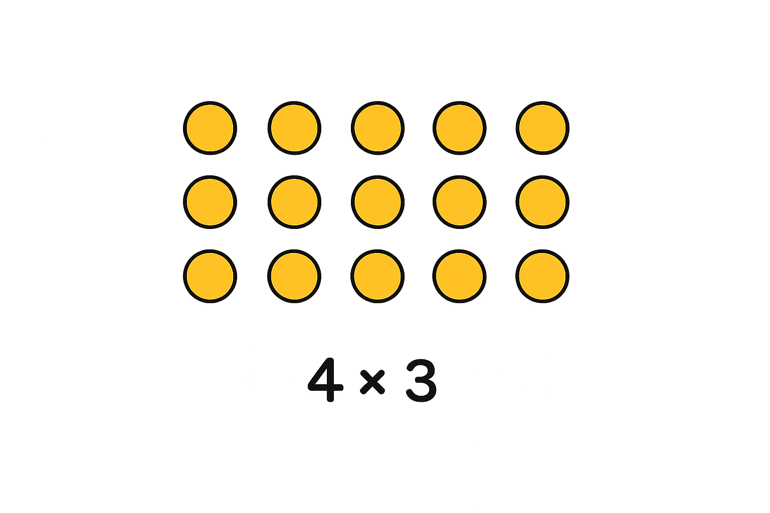
Your Turn
Draw an array to show:
4 x 3
3 x 4
What do you notice?
What’s the same and what’s different?

