Slide 1


Lesson 1:
x4 Table
(Focus 11 x 4)
www.arithmagicians.com

Slide 2

+4
+4
+4
+4
+4
+4
+4
+4
+4
+4
0
4
8
12
16
20
24
28
32
36
40
Get ready to count up in 4s

Slide 3
-4
-4
-4
-4
-4
-4
-4
-4
-4
4
8
12
16
20
24
28
32
36
40
Get ready to count back in 4s

Slide 4


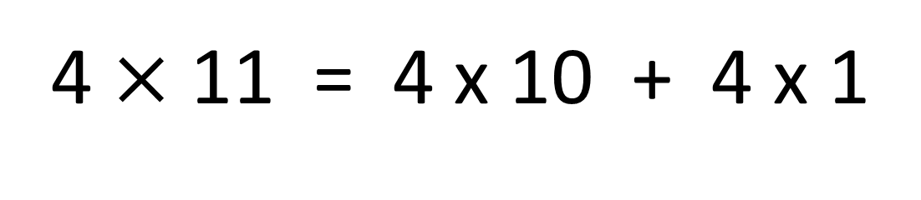

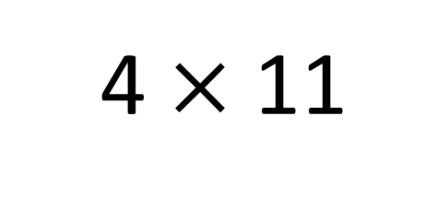
True
True or False
=
4 $×$ 11 = 4 x 10 + 4 x 1
4 $×$ 11
4 $×$ 10 + 4 x 1
=
4
___ groups of 11 is the same as 4 groups
of ____ plus one group of ___
10
4

Slide 5


Your Turn
Answer the questions below and be ready to explain which strategy you used.
20
5) 4 x 4 =
16
1) 5 x 4 =
2) 11 x 4 =
44
6) 8 x 4 =
32
3) 6 x 4 =
24
7) 4 x 7 =
28
4) 3 x 4 =
12
8) 4 x 12 =
48

Slide 6

True or False
4 x 11 = 4 x 10 + 4
True

