Slide 1
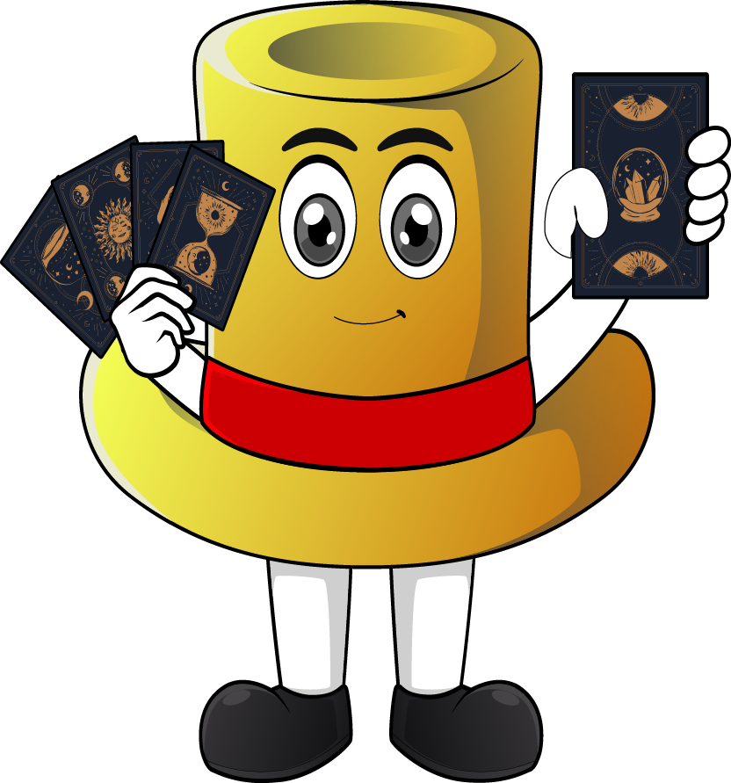

Lesson 2:
x4 Table
(Focus 12 x 4)
www.arithmagicians.com

Slide 2

+4
+4
+4
+4
+4
+4
+4
+4
+4
+4
0
4
8
12
16
20
24
28
32
36
40
Get ready to count up in 4s

Slide 3
-4
-4
-4
-4
-4
-4
-4
-4
-4
4
8
12
16
20
24
28
32
36
40
Get ready to count back in 4s

Slide 4



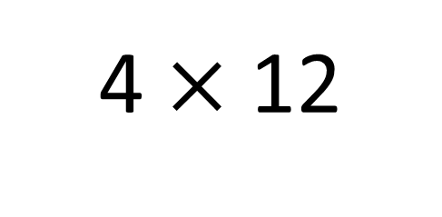
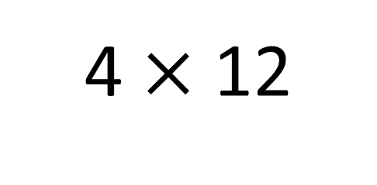
True
True or False
48
4 $×$ 12
=
4 $×$ 12
= 4 $×$ 10 + 4 x 2
4 x 10 + 4 x 2
=
40
8
4
___ groups of 12 is the same as 4 groups
of ____ plus 4 group of ___
10
2

Slide 5


Your Turn
Answer the questions below and be ready to explain which strategy you used.
20
5) 3 x 4 =
12
1) 4 x 5 =
2) 12 x 4 =
48
6) 6 x 4 =
24
3) 8 x 4 =
32
7) 4 x 9 =
36
4) 4 x 4 =
16
8) 4 x 7 =
28

Slide 6

True or False
4 x 12 = 4 x 10 + 4 + 4
True

