Slide 1
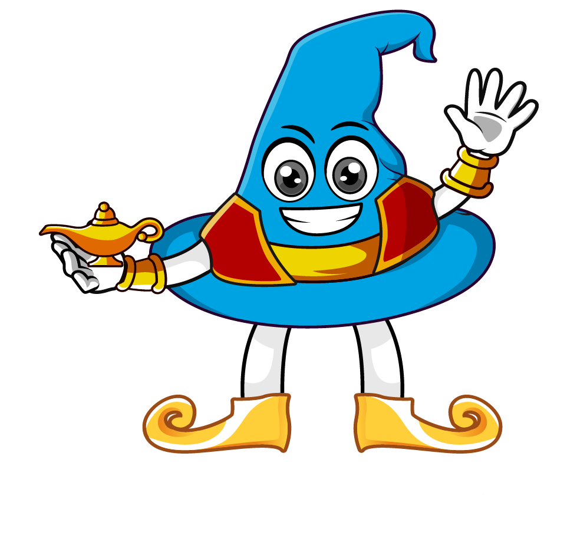

Lesson 2:
Understanding Percentages
As Decimals
www.arithmagicians.com

Slide 2

This square represents 1 whole.
Imagine we take this square and
split it into 10 equal parts.
Imagine we split the square
into 100 equal parts.
If I shade 1 part, I have 0.01
If I shade 1 part, I have 0.1

Slide 3

26 %
0.26 = ? %
Percentage
‘out of’
‘one hundred’

Slide 4
77 %
0.77 = ? %
Percentage
‘out of’
‘one hundred’

Slide 5
20 %
0.2 = ?%
Percentage
‘out of’
‘one hundred’

Slide 6
2 %
0.02 = ? %
Percentage
‘out of’
‘one hundred’

Slide 7
40 %
0.4 = ? %
Percentage
‘out of’
‘one hundred’

Slide 8
4 %
0.04 = ? %
Percentage
‘out of’
‘one hundred’

Slide 9


Your Turn
Convert the following decimals to percentages
1) 0.3 =
30%
1) 0.57 =
57%
2) 0.03 =
3%
2) 0.01 =
1%
3) 0.8 =
80%
3) 0.1 =
10%
4) 0.08 =
8%
4) 0.11 =
11%
5) 0.95 =
95%
5) 1 =
100%

Slide 10

True or False
0.01 is equal to 10%
False: Can you explain why?

