Slide 1


Lesson 4:
Recap: Percentage of an amount
www.arithmagicians.com

Slide 2


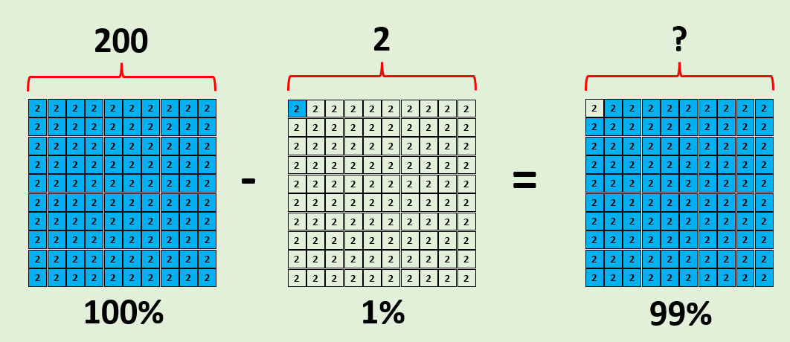
99% of 200
Jasmine
First, I will calculate 100% and 1% of 200
I know that:
100% – 1% = 99%
200 – 2 = 198
So, 99% of 200 = 198
100% = 200
1% = 2
198

Slide 3

90% of 200
2
2
2
2
2
2
2
2
2
2
Aisha:
First, I will calculate 10%.
2
2
2
2
2
2
2
2
2
2
2
2
2
2
2
2
2
2
2
2
90% + 9% = 99%
180 + 18 = 198
Next, I will calculate 1% & multiply it by 9
1% = 2
9% = 18
2
2
2
2
2
2
2
2
2
2
10% = 20
90% = 180
10% of 200 = 20
Next, I will multiply 20 by 9
2
2
2
2
2
2
2
2
2
2
x9
2
2
2
2
2
2
2
2
2
2
x9
2
2
2
2
2
2
2
2
2
2
2
2
2
2
2
2
2
2
2
2
2
2
2
2
2
2
2
2
2
2
2
2
2
2
2
2
2
2
2
2
200

Slide 4


Find 99% of 800
Jasmine:
I will find 100% and subtract 1% from it
+6
+6
+6
0
6
12
18
Amy:
I will find 90% and add it to 9%
+3
+3
+3
+3
+3
+3
0
3
6
9
12
15
18
Which method do you prefer – why?

Slide 5
4% of 200
2
2
2
2
2
2
2
2
2
2
Amy:
First, I will calculate 1%.
2
2
2
2
2
2
2
2
2
2
2
2
2
2
2
2
2
2
2
2
So,
4% of 200 = 8
1% of 200 = 2
1% = 2
4% = 8
2
2
2
2
2
2
2
2
2
2
Next, I will multiply 2 by 4
2
2
2
2
2
2
2
2
2
2
x4
2
2
2
2
2
2
2
2
2
2
2
2
2
2
2
2
2
2
2
2
2
2
2
2
2
2
2
2
2
2
2
2
2
2
2
2
2
2
2
2
2
2
2
2
2
2
2
2
2
2
200

Slide 6
Find 7% of 500
5
1% of 500 = _____
x7
35
7% of 500 = _____

Slide 7

40% of 200
2
2
2
2
2
2
2
2
2
2
Ben:
First, I will calculate 10%.
2
2
2
2
2
2
2
2
2
2
2
2
2
2
2
2
2
2
2
2
So,
40% of 200 = 80
10% = 20
40% = 80
10% of 200 = 20
2
2
2
2
2
2
2
2
2
2
Next, I will multiply 20 by 4
2
2
2
2
2
2
2
2
2
2
x4
2
2
2
2
2
2
2
2
2
2
2
2
2
2
2
2
2
2
2
2
2
2
2
2
2
2
2
2
2
2
2
2
2
2
2
2
2
2
2
2
2
2
2
2
2
2
2
2
2
2
200

Slide 8
Find 70% of 500
50
10% of 500 = _____
x7
350
70% of 500 = _____

Slide 9


Your Turn
1) 99% of 400 =
396
5) 70% of 80 =
56
2) 90% of 400 =
360
6) 40% of 80 =
32
3) 9% of 400 =
36
7) 5% of 80 =
4
4) 2% of 400 =
8
2.4
8) 3% of 80 =

Slide 10

True or False
20% of a number is the same as one quarter of the number.
False: can you explain why?

