Slide 1
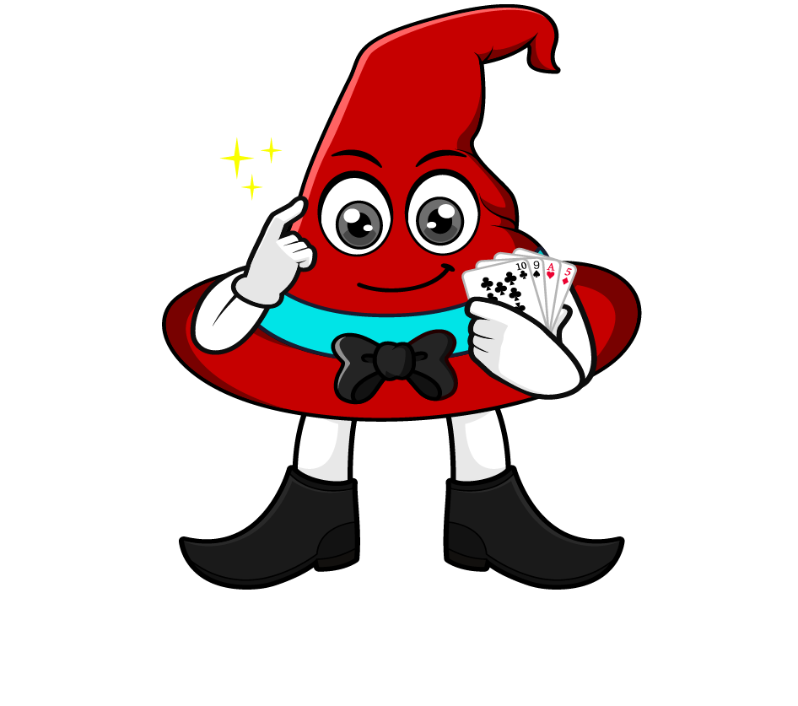

Lesson 1:
Equivalent Fractions, Decimals & Percentages: Quarters
www.arithmagicians.com

Slide 2

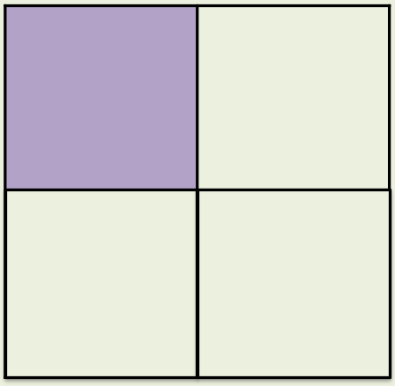
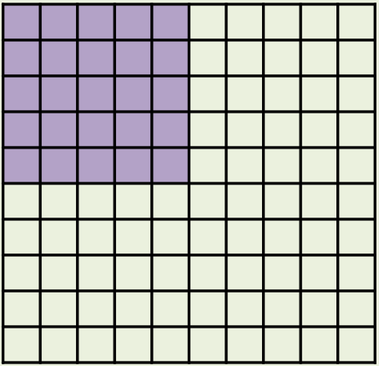
What’s the same and what’s different?
Fraction
Decimal
Percentage
¼
0.25
25%
_____
_____
_____

Slide 3
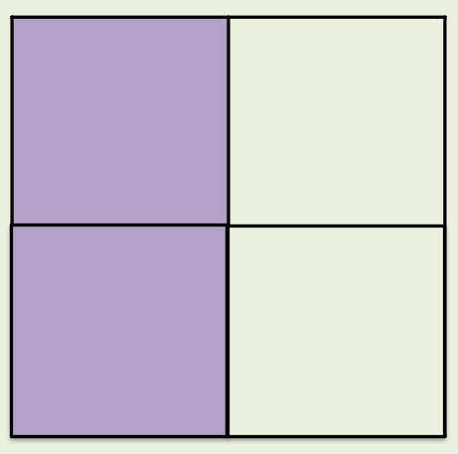
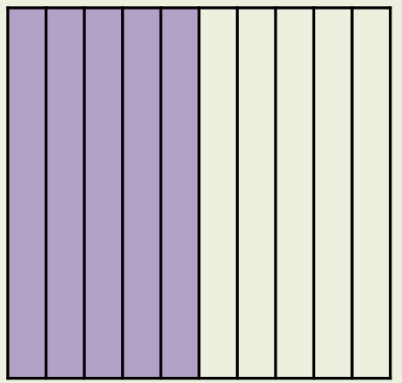
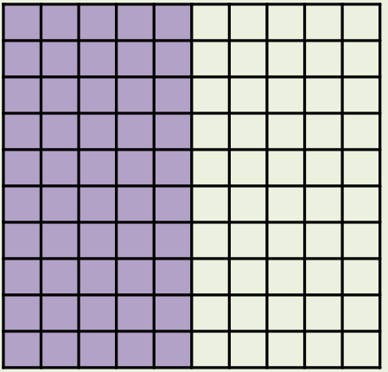
What’s the same and what’s different?
Fraction
Decimal
Percentage
1/2 or 2/4
0.5
50%
_____
_____
_____

Slide 4
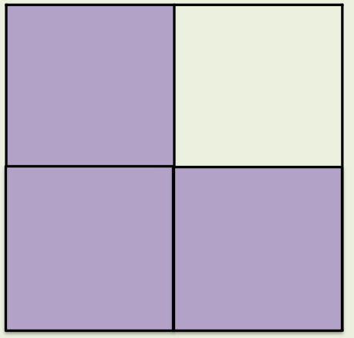
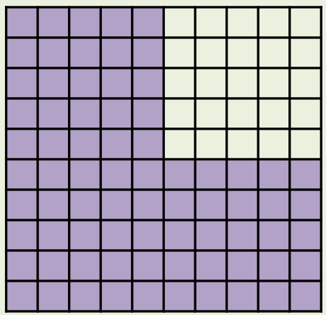
What’s the same and what’s different?
Fraction
Decimal
Percentage
3/4
0.75
75%
_____
_____
_____

Slide 5
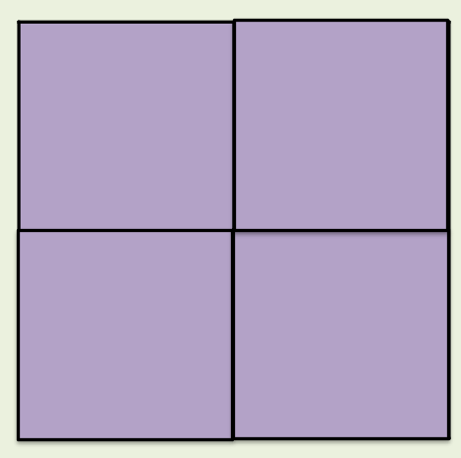
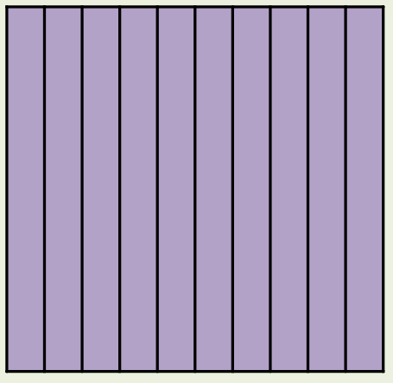
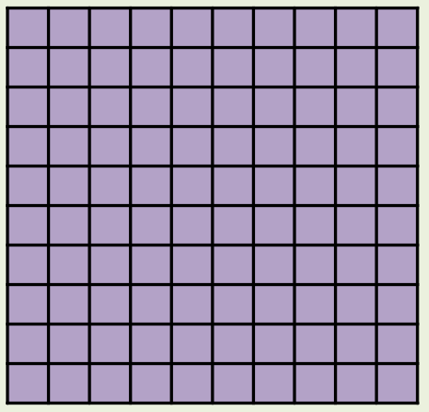
What’s the same and what’s different?
Fraction
Decimal
Percentage
4/4 or 1 whole
1
100%
_____
_____
_____

Slide 6


Your Turn
You should know these by heart
Fraction | Decimal | Percentage
2/4
 |  | 25%
3/4
 | 1
0.5
50%
1/4
0.25
0.75
75%
4/4
100%

Slide 7
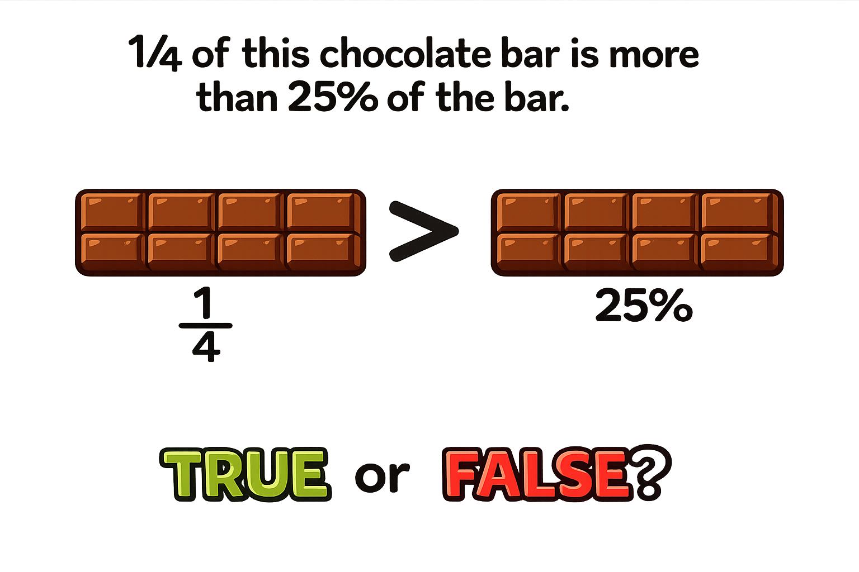
False: Can you explain why?

