Slide 1
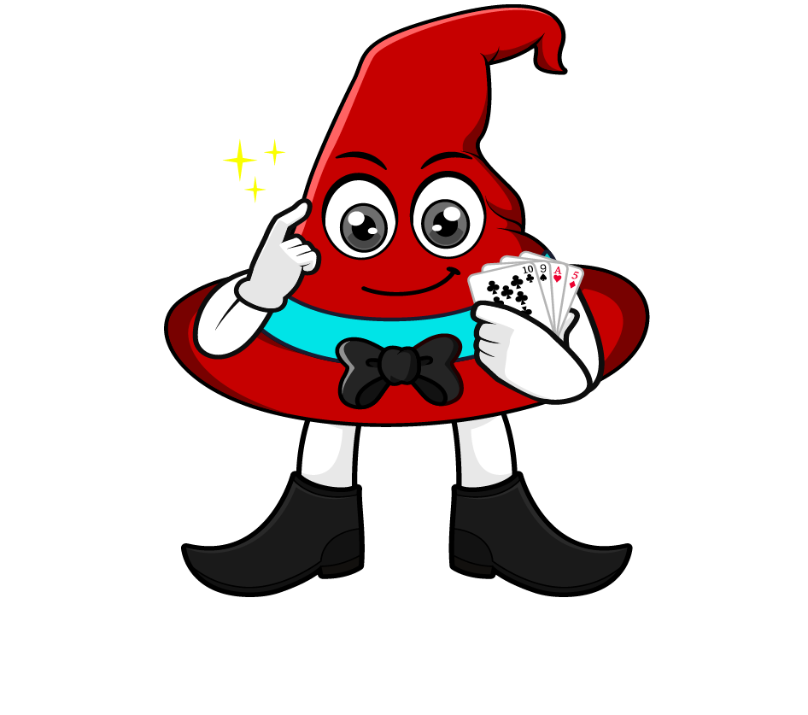

Lesson 1:
Percentage of an amount:
Missing Values
www.arithmagicians.com

Slide 2

50% of ? = 200
50% of 400 = 200
?
400
200
200
200
One part is _______
200
The whole is _______
400

Slide 3

50% of ? = 250
50% of 500 = 250
500
?
250
250
250
One part is _______
250
The whole is _______
500

Slide 4
25% of 800 = 200
25% of ? = 200
?
800
200
200
200
200
200
One part is _______
200
The whole is _______
800

Slide 5
25% of 1000 = 250
25% of ? = 250
1000
?
250
250
250
250
250
One part is _______
250
The whole is _______
1000

Slide 6


Your Turn
200
1) 50% of ? = 100
80
2) 25% of ? = 20
80
3) 50% of ? = 40
1200
4) 25% of ? = 300

Slide 7

True or False
50% of ? = 300
The answer is 150
False: Can you explain why?

