Slide 1


Lesson 2:
Equivalent Fractions, Decimals & Percentages: Fifths
www.arithmagicians.com

Slide 2

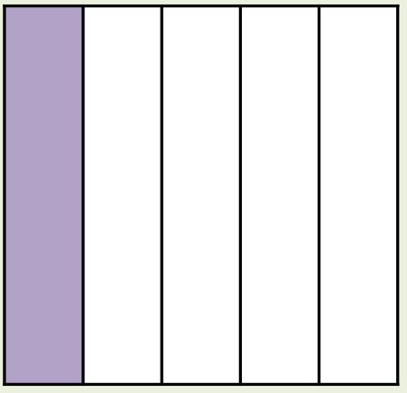
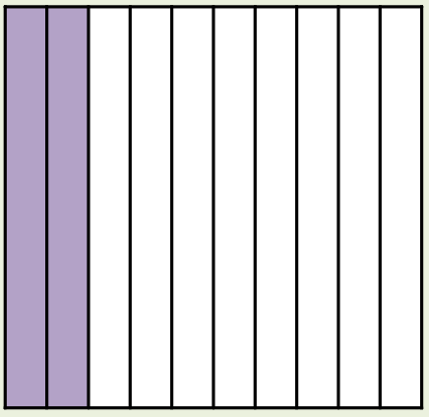
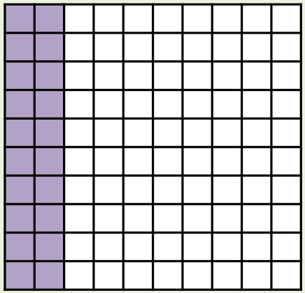
What’s the same and what’s different?
Fraction
Decimal
Percentage
1/5
0.2
20%
_____
_____
_____

Slide 3
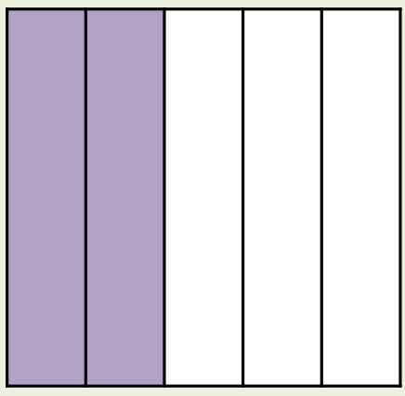
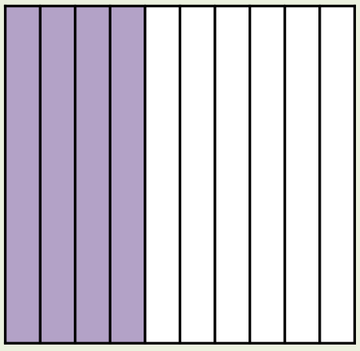
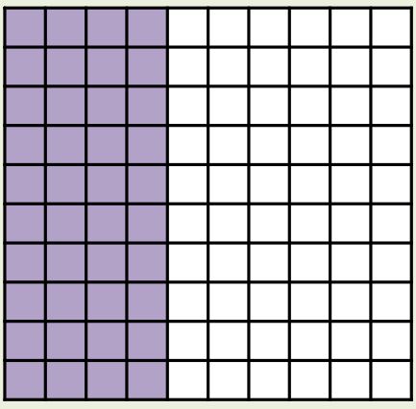
What’s the same and what’s different?
Fraction
Decimal
Percentage
2/5
0.4
40%
_____
_____
_____

Slide 4
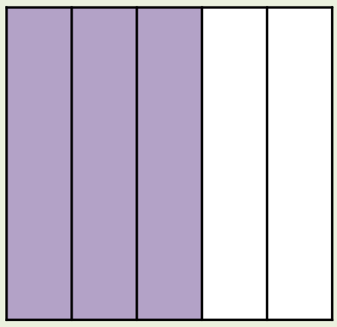
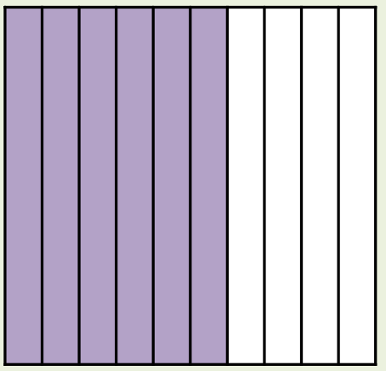
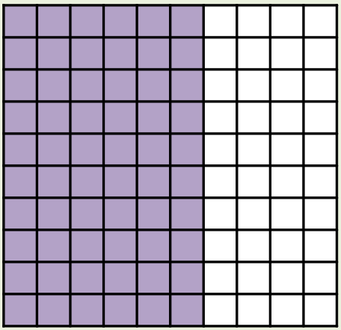
What’s the same and what’s different?
Fraction
Decimal
Percentage
3/5
0.6
60%
_____
_____
_____

Slide 5
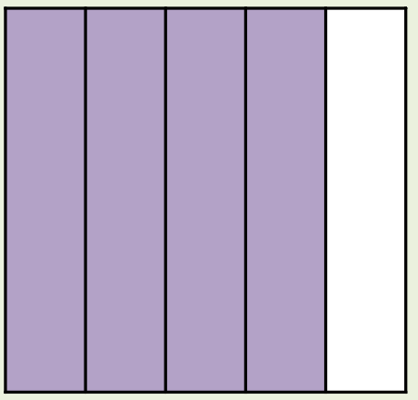
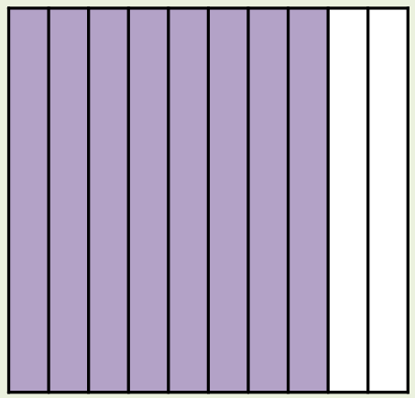
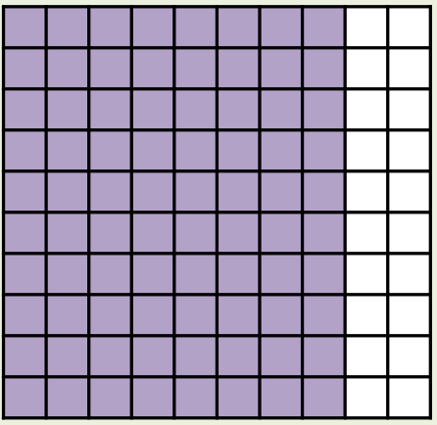
What’s the same and what’s different?
Fraction
Decimal
Percentage
4/5
0.8
80%
_____
_____
_____

Slide 6
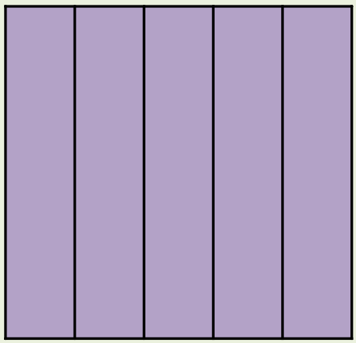
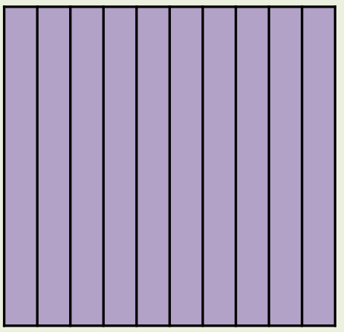
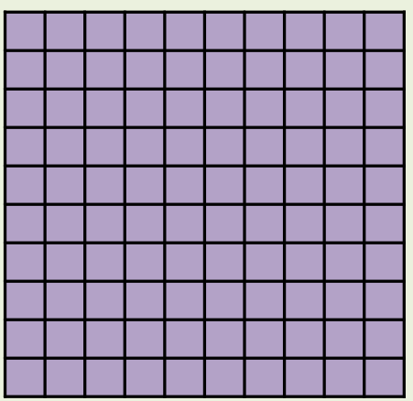
What’s the same and what’s different?
Fraction
Decimal
Percentage
5/5
1
100%
_____
_____
_____

Slide 7


Your Turn
You should know these by heart
Fraction | Decimal | Percentage
2/5
 |  | 80%
3/5
 | 0.2
0.4
40%
4/5
0.8
0.6
60%
1/5
20%

Slide 8
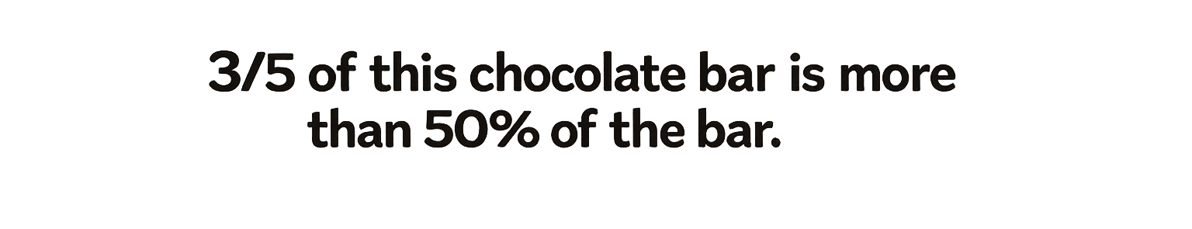

True: Can you explain why?

