Slide 1
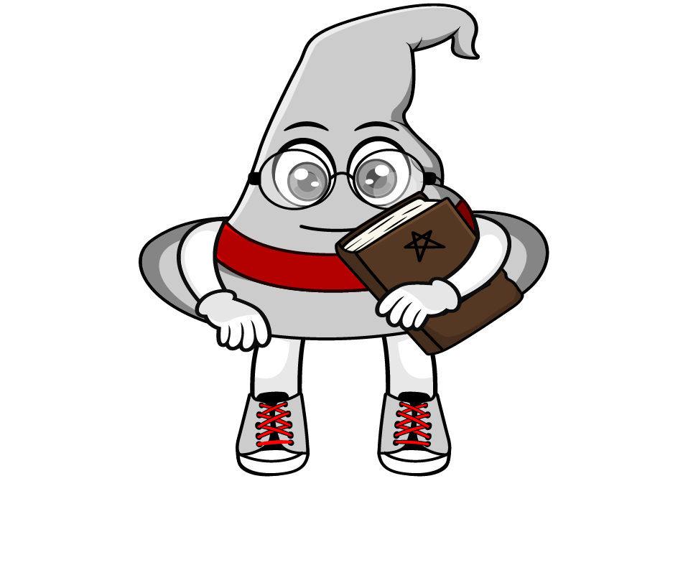

Lesson 2:
Percentage of an amount:
Missing Values
www.arithmagicians.com

Slide 2

20% of 500 = 100
20% of ? = 100
500
?
100
100
100
100
100
100
One part is _______
100
The whole is _______
500

Slide 3

20% of ? = 60
20% of 300 = 60
300
?
60
60
60
60
60
60
One part is _______
60
The whole is _______
300

Slide 4


Your Turn
250
200
1) 20% of ? = 50
4) 20% of ? = 40
200
160
2) 25% of ? = 50
5) 25% of ? = 40
100
80
3) 50% of ? = 50
6) 50% of ? = 40

Slide 5

True or False
20% of ? = 30
The answer is 6
False: Can you explain why?

