Slide 1


Lesson 3:
Equivalent Fractions, Decimals & Percentages: Tenths
www.arithmagicians.com

Slide 2

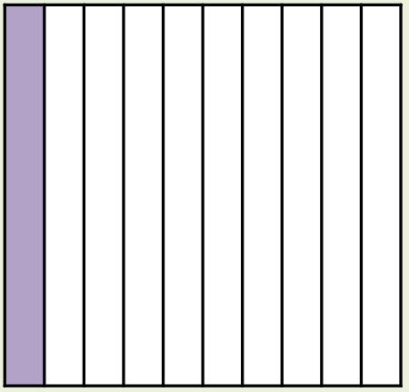
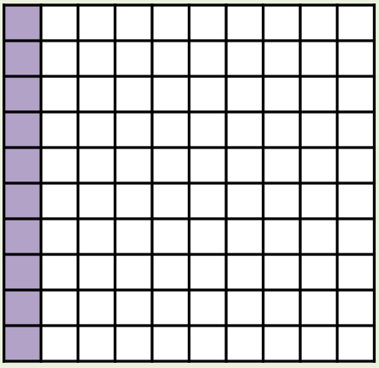
What’s the same and what’s different?
Fraction
Decimal
Percentage
1/10
0.1
10%
_____
_____
_____

Slide 3
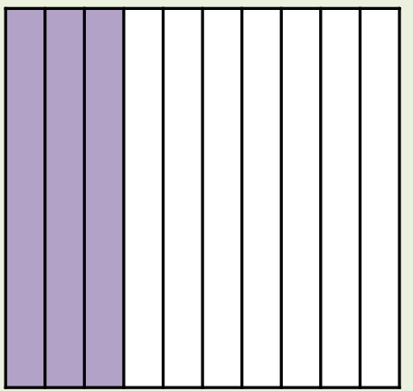
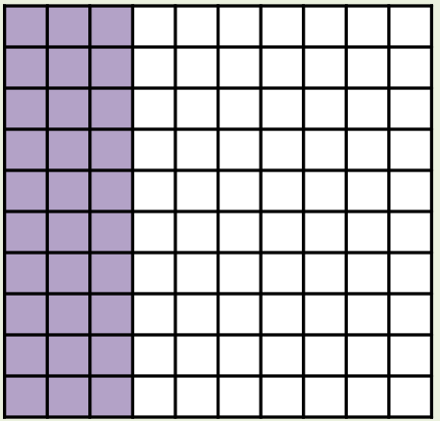
What’s the same and what’s different?
Fraction
Decimal
Percentage
3/10
0.3
30%
_____
_____
_____

Slide 4
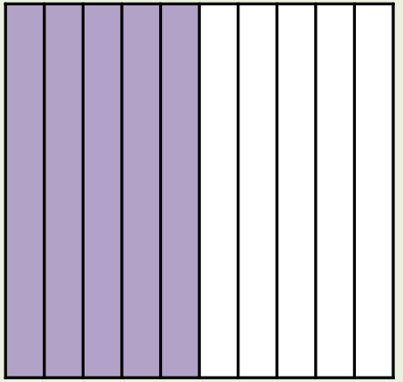
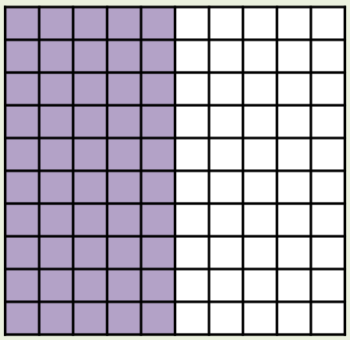
What’s the same and what’s different?
Fraction
Decimal
Percentage
5/10 or 1/2
0.5
50%
_____
_____
_____

Slide 5
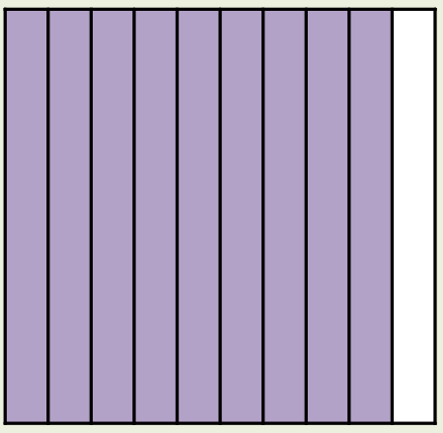
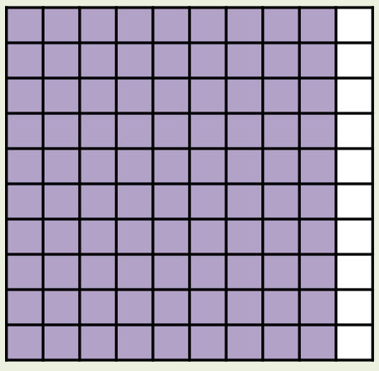
What’s the same and what’s different?
Fraction
Decimal
Percentage
9/10
0.9
90%
_____
_____
_____

Slide 6
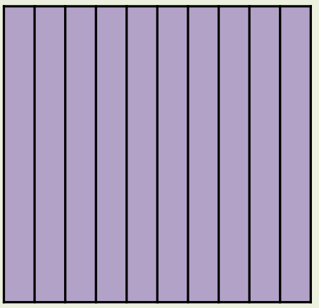
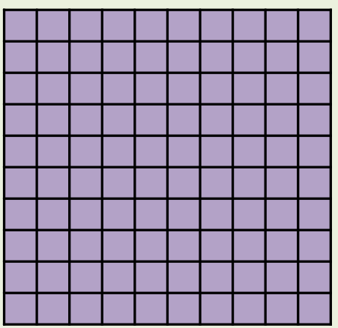
What’s the same and what’s different?
Fraction
Decimal
Percentage
10/10
1
100%
_____
_____
_____

Slide 7


Your Turn
You should know these by heart
Fraction | Decimal | Percentage
2/10
 |  | 70%
8/10
 | 0.1
0.2
20%
7/10
0.7
0.8
80%
1/10
10%

Slide 8
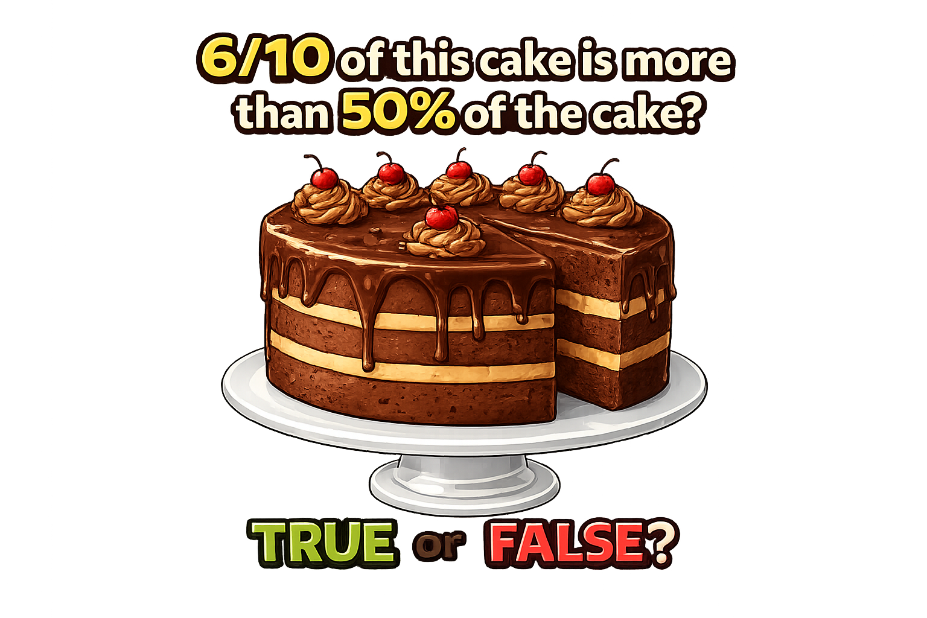
True: Can you explain why?

