Slide 1


Lesson 4:
x2 Missing numbers
www.arithmagicians.com

Slide 2

-2
-2
-2
-2
-2
-2
-2
-2
-2
2
4
6
8
10
12
14
16
18
20
Get ready to count back in 2s

Slide 3

2 x 7 = 14
2 x ? = 14
14
14
?
?
7
7
14
2
The whole is ___. There are ___ equal parts.
7
I know that 2 × ___ = 14
so each part must be ___.
7
Therefore, the missing number is ____.
7

Slide 4


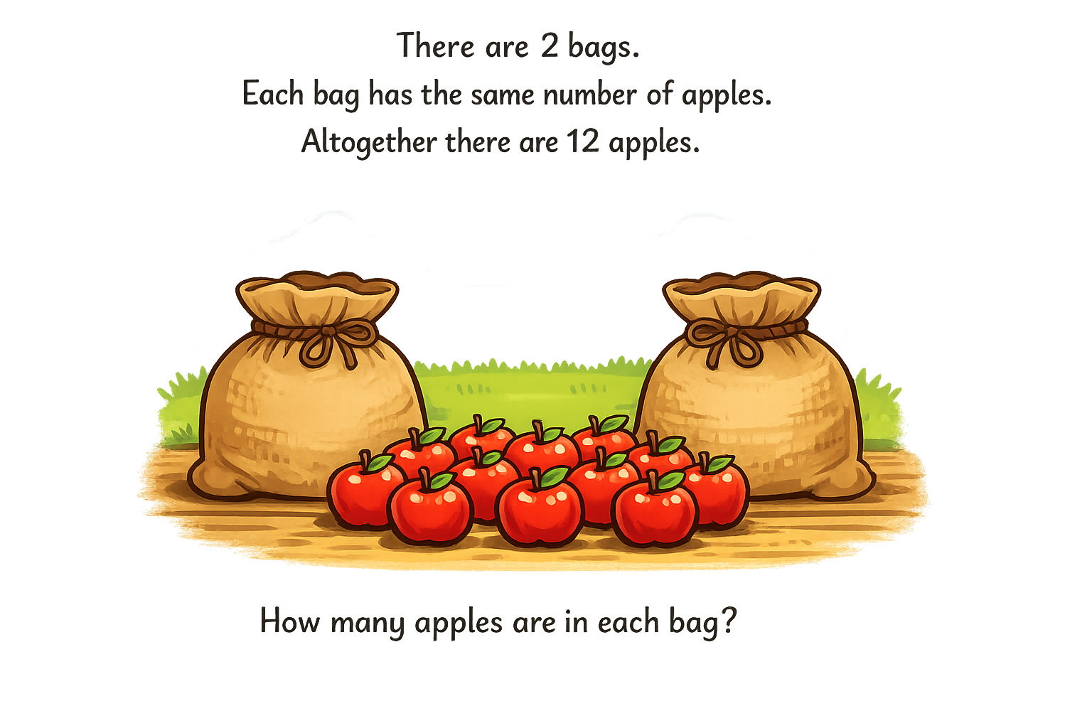
Your Turn
2 x ? = 12
6
6

Slide 5
True or False
If 2 × ? = 8, then ? = 8
False

