Slide 1


Lesson 4:
X4 table
Missing Numbers
www.arithmagicians.com

Slide 2

+4
+4
+4
+4
+4
+4
+4
+4
+4
+4
0
4
8
12
16
20
24
28
32
36
40
Get ready to count up in 4s

Slide 3
-4
-4
-4
-4
-4
-4
-4
-4
-4
4
8
12
16
20
24
28
32
36
40
Get ready to count back in 4s

Slide 4


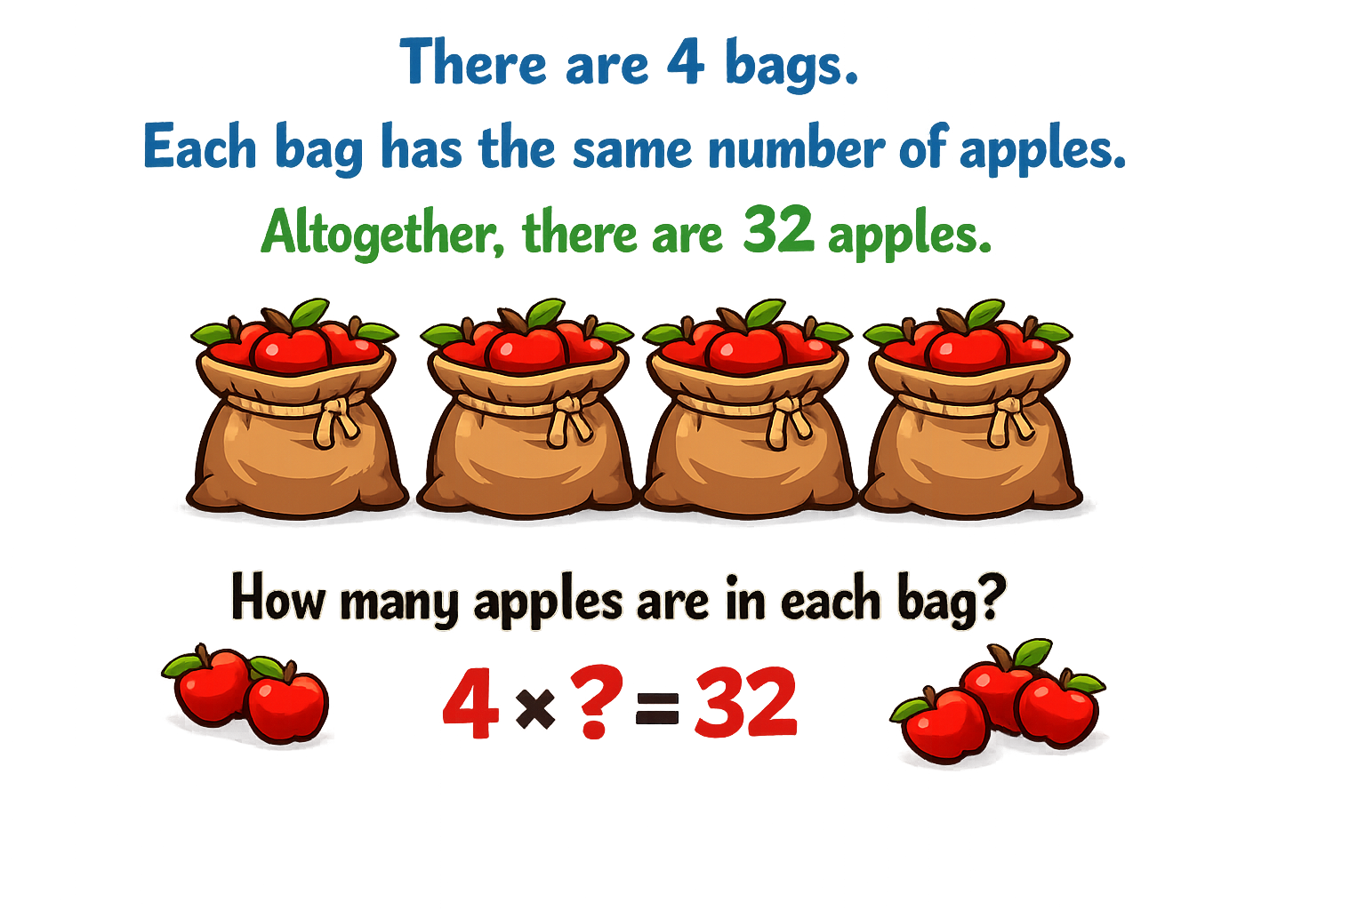
Your Turn
8
8
8
8

Slide 5
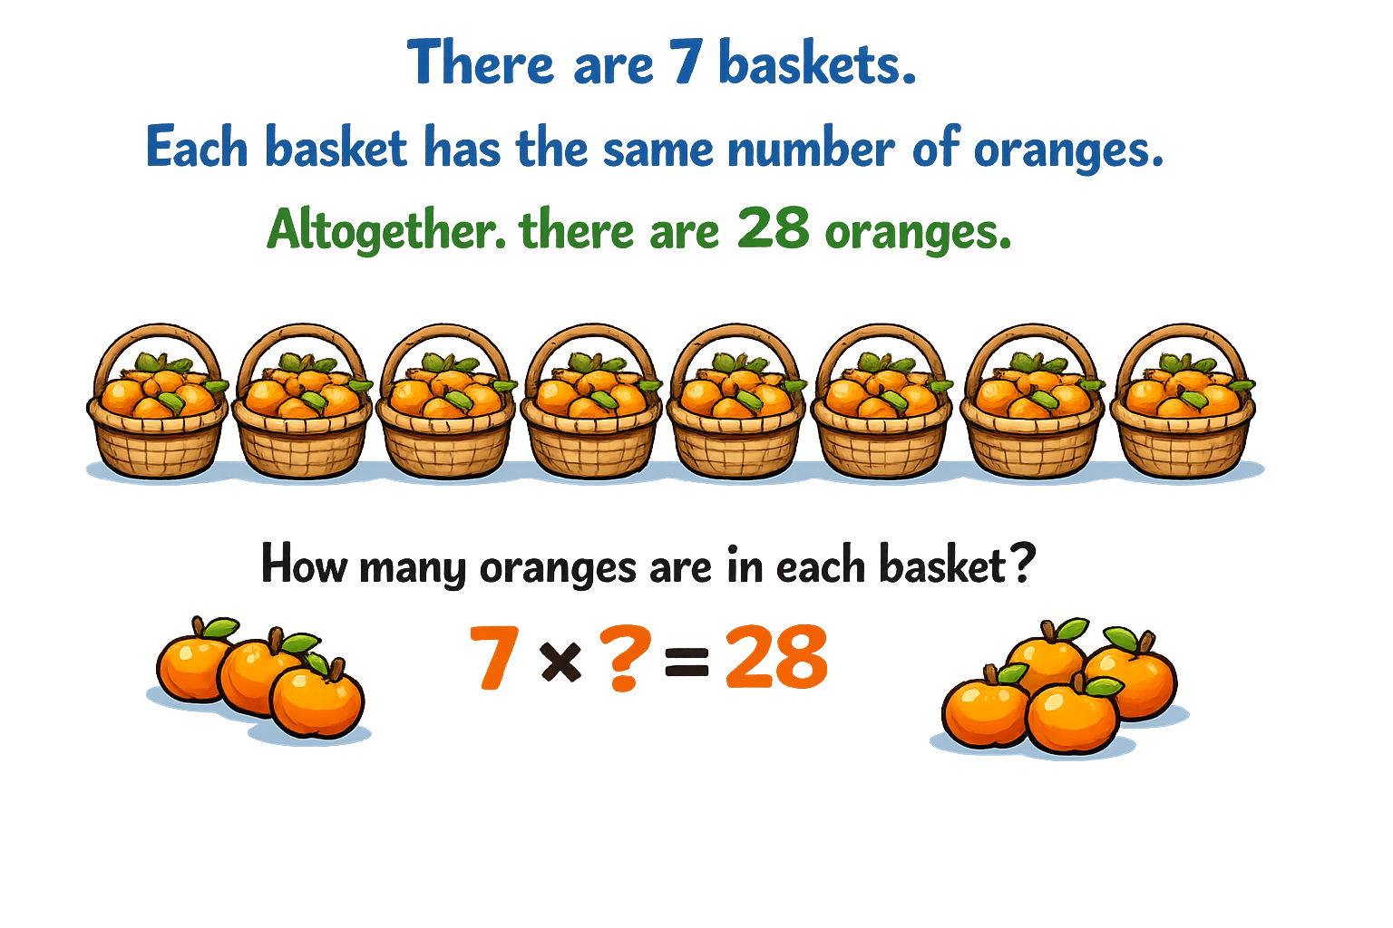
Your Turn
4
4
4
4
4
4
4

Slide 6


True or False
4 x 11 = 4 x 10 + 10
False: What mistake did Novice make?

