Slide 1
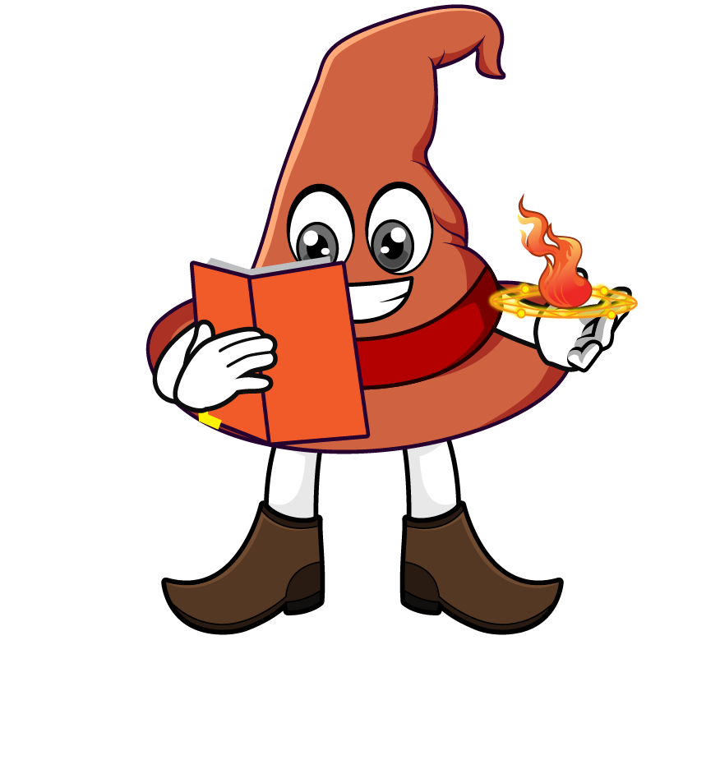

Lesson 4:
Equivalent Fractions, Decimals & Percentages: Hundredths
www.arithmagicians.com

Slide 2

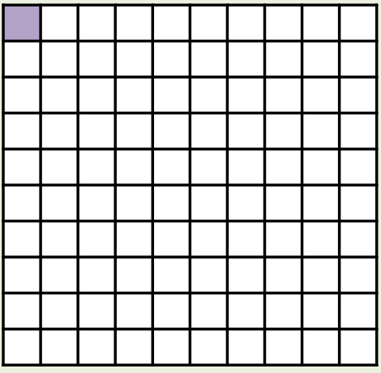
What’s the same and what’s different?
Fraction
Decimal
Percentage
1/100
0.01
1%
_____
_____
_____

Slide 3
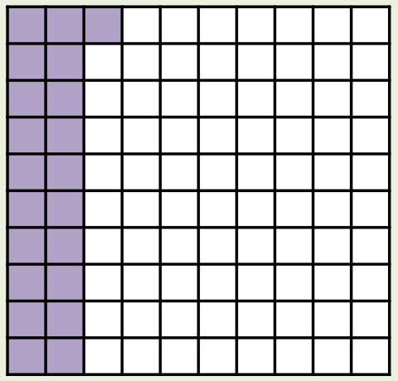
What’s the same and what’s different?
Fraction
Decimal
Percentage
21/100
0.21
21%
_____
_____
_____

Slide 4
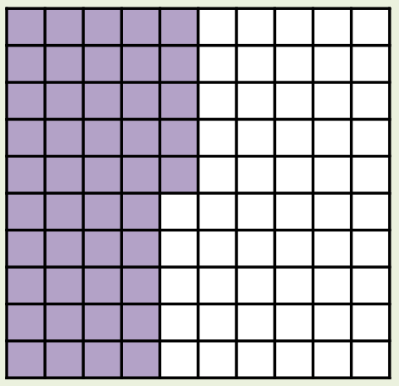
What’s the same and what’s different?
Fraction
Decimal
Percentage
45/100
0.45
45%
_____
_____
_____

Slide 5
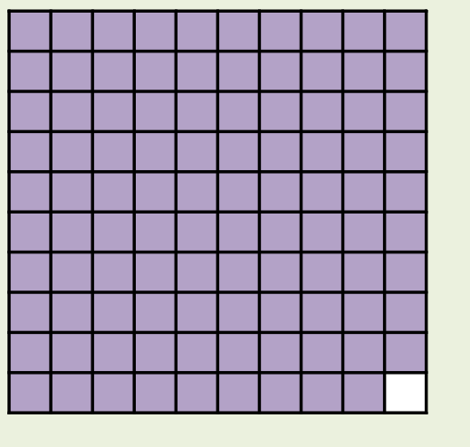
What’s the same and what’s different?
Fraction
Decimal
Percentage
99/100
0.99
99%
_____
_____
_____

Slide 6


Your Turn
Fraction | Decimal | Percentage
7/100
70/100
 |  | 77%
 | 0.01
0.07
7%
0.7
70%
77/100
0.77
1/100
1%

Slide 7
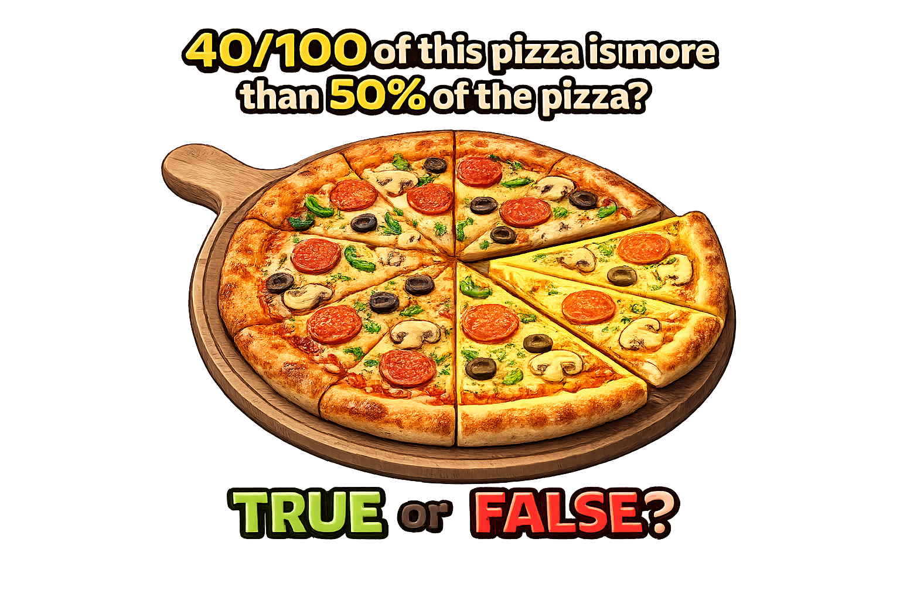
False: Can you explain why?

