Slide 1
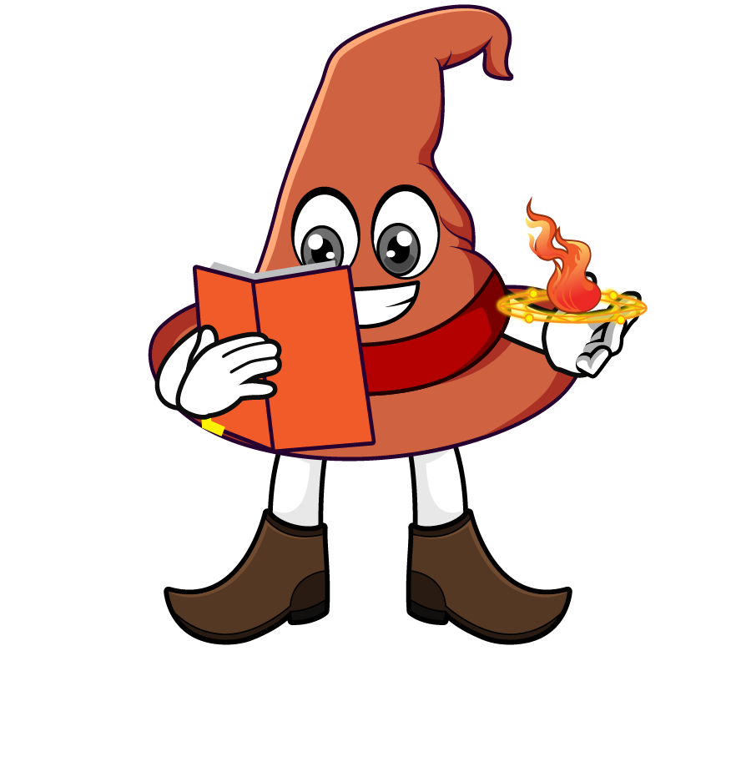

Lesson 4:
Percentage of an amount:
Missing Values
www.arithmagicians.com

Slide 2

25% of 800 = 200
25% of ? = 200
?
800
200
200
200
200
200
One part is _______
200
The whole is _______
800

Slide 3

25% of 1000 = 250
25% of ? = 250
1000
?
250
250
250
250
250
One part is _______
250
The whole is _______
1000

Slide 4
20% of ? = 60
20% of 300 = 60
300
?
60
60
60
60
60
60
One part is _______
60
The whole is _______
300

Slide 5
10% of 300 = 30
10% of ? = 30
300
?
30
30
30
30
30
30
30
30
30
30
30
One part is _______
30
The whole is _______
300

Slide 6


Your Turn
800
1) 10% of ? = 80
400
2) 20% of ? = 80
160
3) 50% of ? = 80
320
4) 25% of ? = 80

Slide 7

True or False
100% of ? = 53
The answer is 53
True

