Slide 1


Lesson 5:
Assess and Review
www.arithmagicians.com

Slide 2

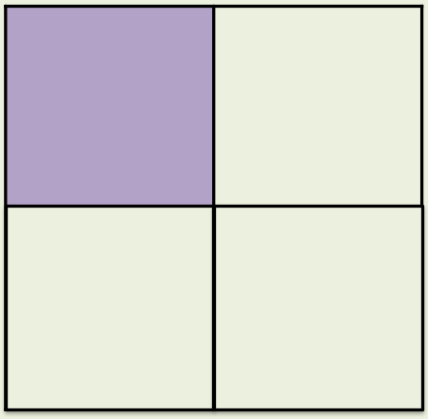
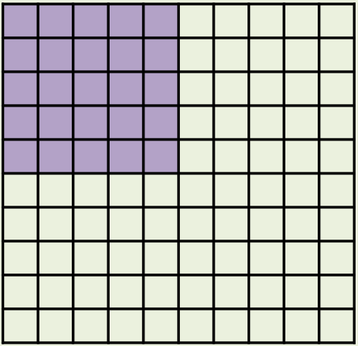
What’s the same and what’s different?
Fraction
Decimal
Percentage
¼
0.25
25%
_____
_____
_____

Slide 3
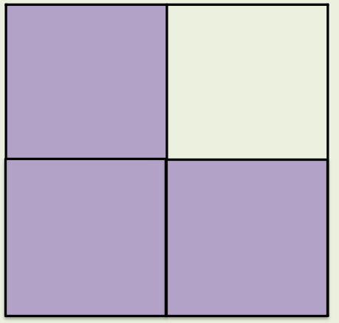
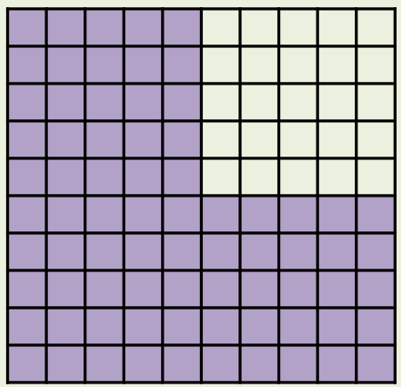
What’s the same and what’s different?
Fraction
Decimal
Percentage
3/4
0.75
75%
_____
_____
_____

Slide 4
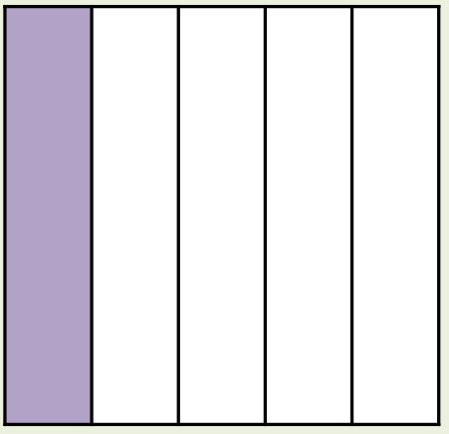
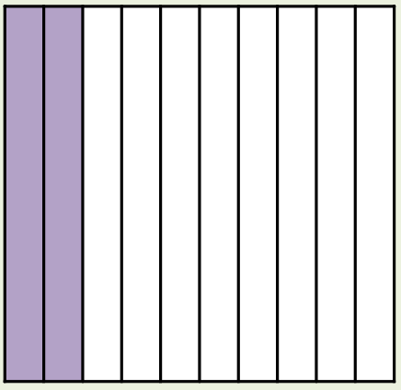
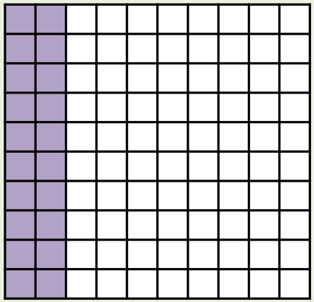
What’s the same and what’s different?
Fraction
Decimal
Percentage
1/5
0.2
20%
_____
_____
_____

Slide 5
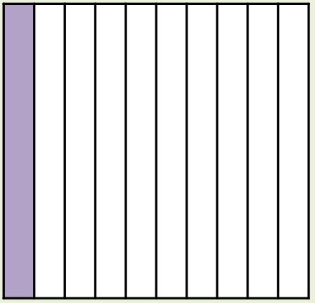
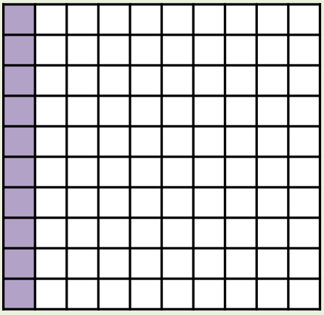
What’s the same and what’s different?
Fraction
Decimal
Percentage
1/10
0.1
10%
_____
_____
_____

Slide 6
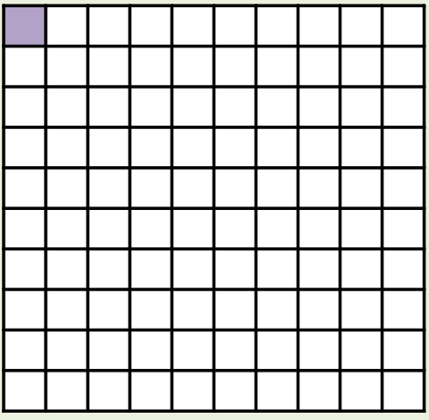
What’s the same and what’s different?
Fraction
Decimal
Percentage
1/100
0.01
1%
_____
_____
_____

Slide 7


Your Turn
You should know these by heart
Fraction | Decimal | Percentage
9/10
 |  | 50%
3/4
 | 0.6
0.9
90%
1/2
0.5
0.75
75%
2/5
60%

