Slide 1
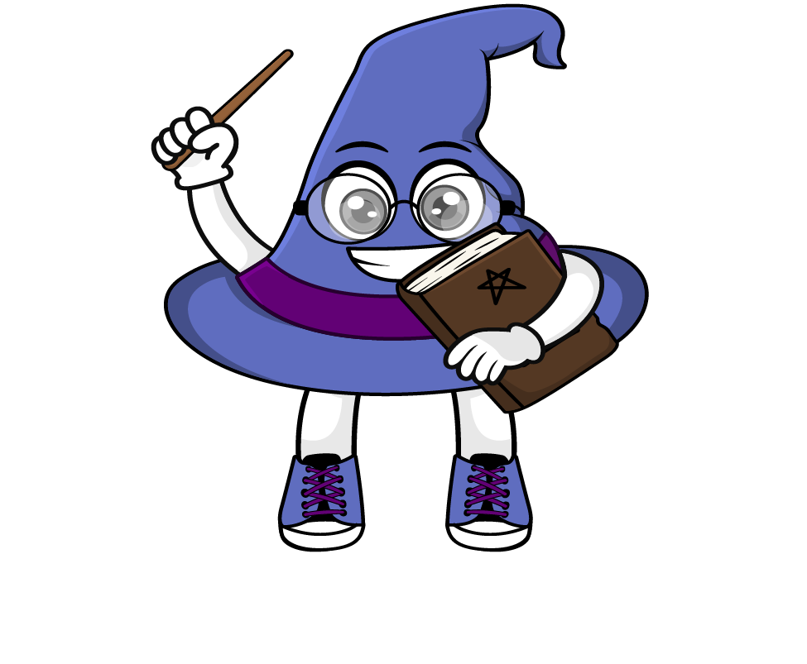
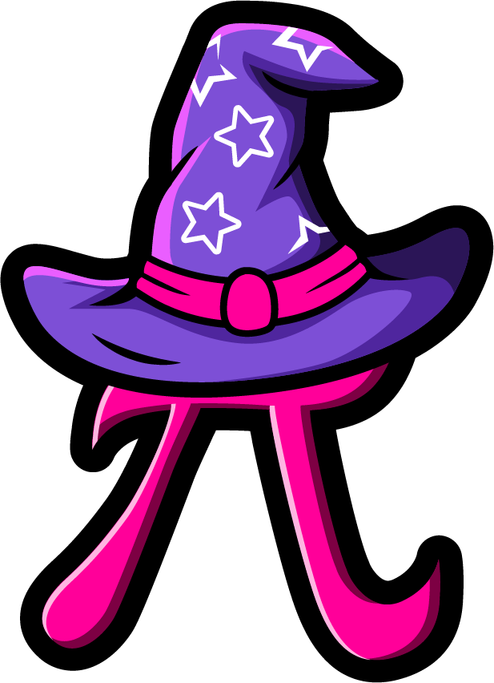
Lesson 1:
Applying percentages in word problems
www.arithmagicians.com

Slide 2

Amir spent 50% of his £24 pocket money.
How much money does he have left?
£24
£12
£12
Spent
Left

Slide 3
A rope is 40 metres long. 25% of it is cut off. How long is the piece that is cut?
40
10
10
10
10
Cut
Left

Slide 4
A farmer has 60 eggs. He sells 25% of them in the morning. How many eggs does he have left?
60 Eggs
15
15
15
15
Sold
Left

Slide 5


Your Turn
A charity raises £200.
50% is spent on food
25% is spent on clothes
How much money is left?
£200
50
50
50
50
Food
Clothes
Left

Slide 6
True or False
25% of a number is half of 50% of the same number.
True: Can you explain why?

