Slide 1
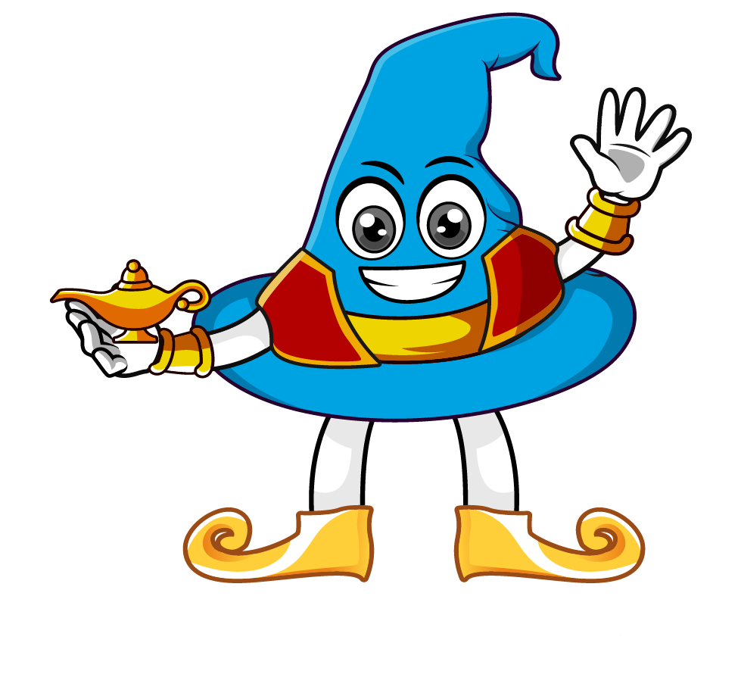

Lesson 2:
Ordering Fractions, Decimals & Percentages
www.arithmagicians.com

Slide 2


Put the following numbers in descending order.
First, I will convert all the numbers into percentages, so that I can compare it easily.
Finally, I will write out the new order.
Next, I will order the percentages from the largest to the smallest.
3/5
70%
1/4
0.07
60%
70%
25%
7%
70%
3/5
1/4
0.07

Slide 3

Put the following numbers in descending order.
First, convert all the numbers into percentages.
Next, order the percentages from largest to smallest.
Finally, write out the new order correctly.
0.08
88%
8/10
3/5
8%
88%
80%
60%
88%
80%
3/5
0.08

Slide 4


Your Turn
Put the following numbers in
descending order.
Make your own example for a friend to complete.
First, convert decimals to percentages.
Next, order the percentages from largest to smallest.
Finally, write out the new order correctly.
1/10
0.05
4/5
40%
10%
5%
80%
40%
4/5
40%
1/10
0.05

Slide 5
True or False
0.1 < 10%
False: Can you explain why?

