Slide 1
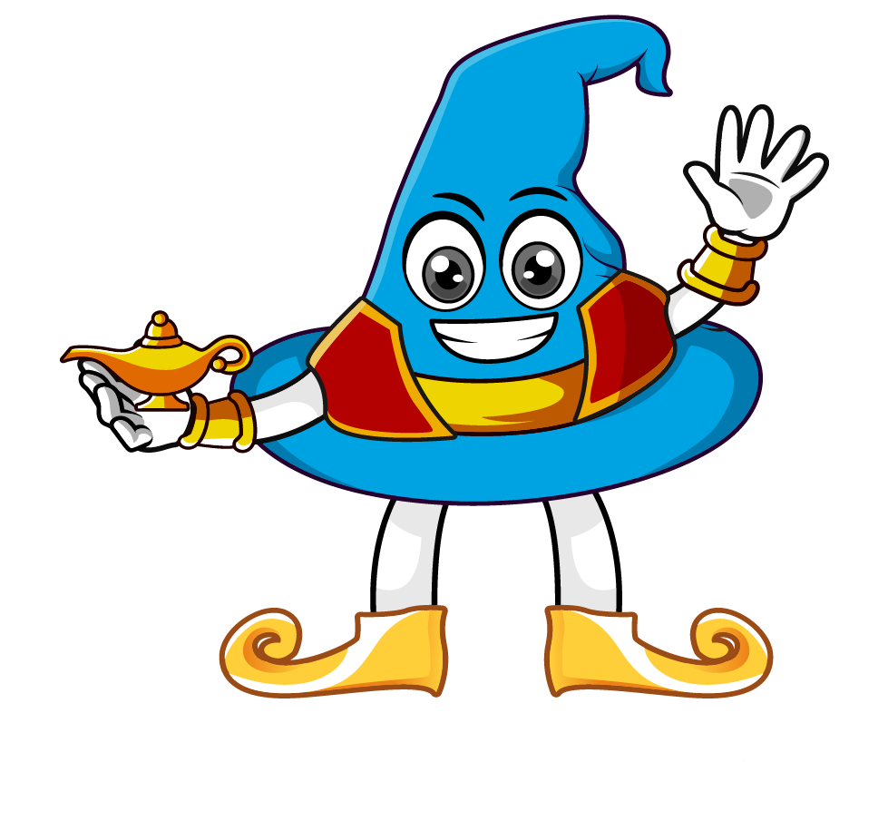

Lesson 2:
Applying percentages in word problems
www.arithmagicians.com

Slide 2

Amy has £50.
She spends 10% of her money on snacks. How much does she spend?
£50
£5
£5
£5
£5
£5
£5
£5
£5
£5
£5
Spent
Left

Slide 3
A jacket costs £60. It is reduced by 20%. What is the new price?
£60
£12
£12
£12
£12
£12
Reduced
New Price

Slide 4


Your Turn
Chris has £400.
10% is spent on games.
20% is spent on food.
How much money does he have left?
£400
£40
£40
£40
£40
£40
£40
£40
£40
£40
£40
Games
Food
Left

Slide 5
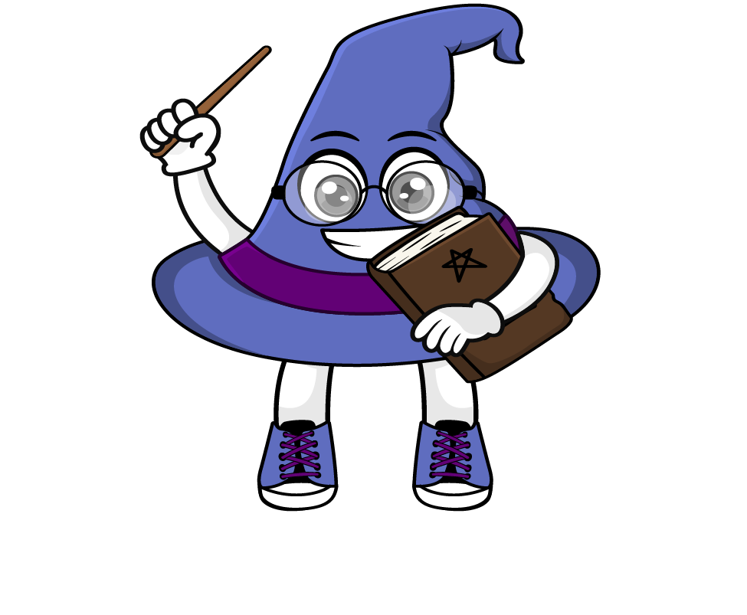
True or False
If you take 20% off a price, you pay 80% of the original price.
True

