Slide 1


Lesson 3:
Applying F, D & P in word problems
www.arithmagicians.com

Slide 2

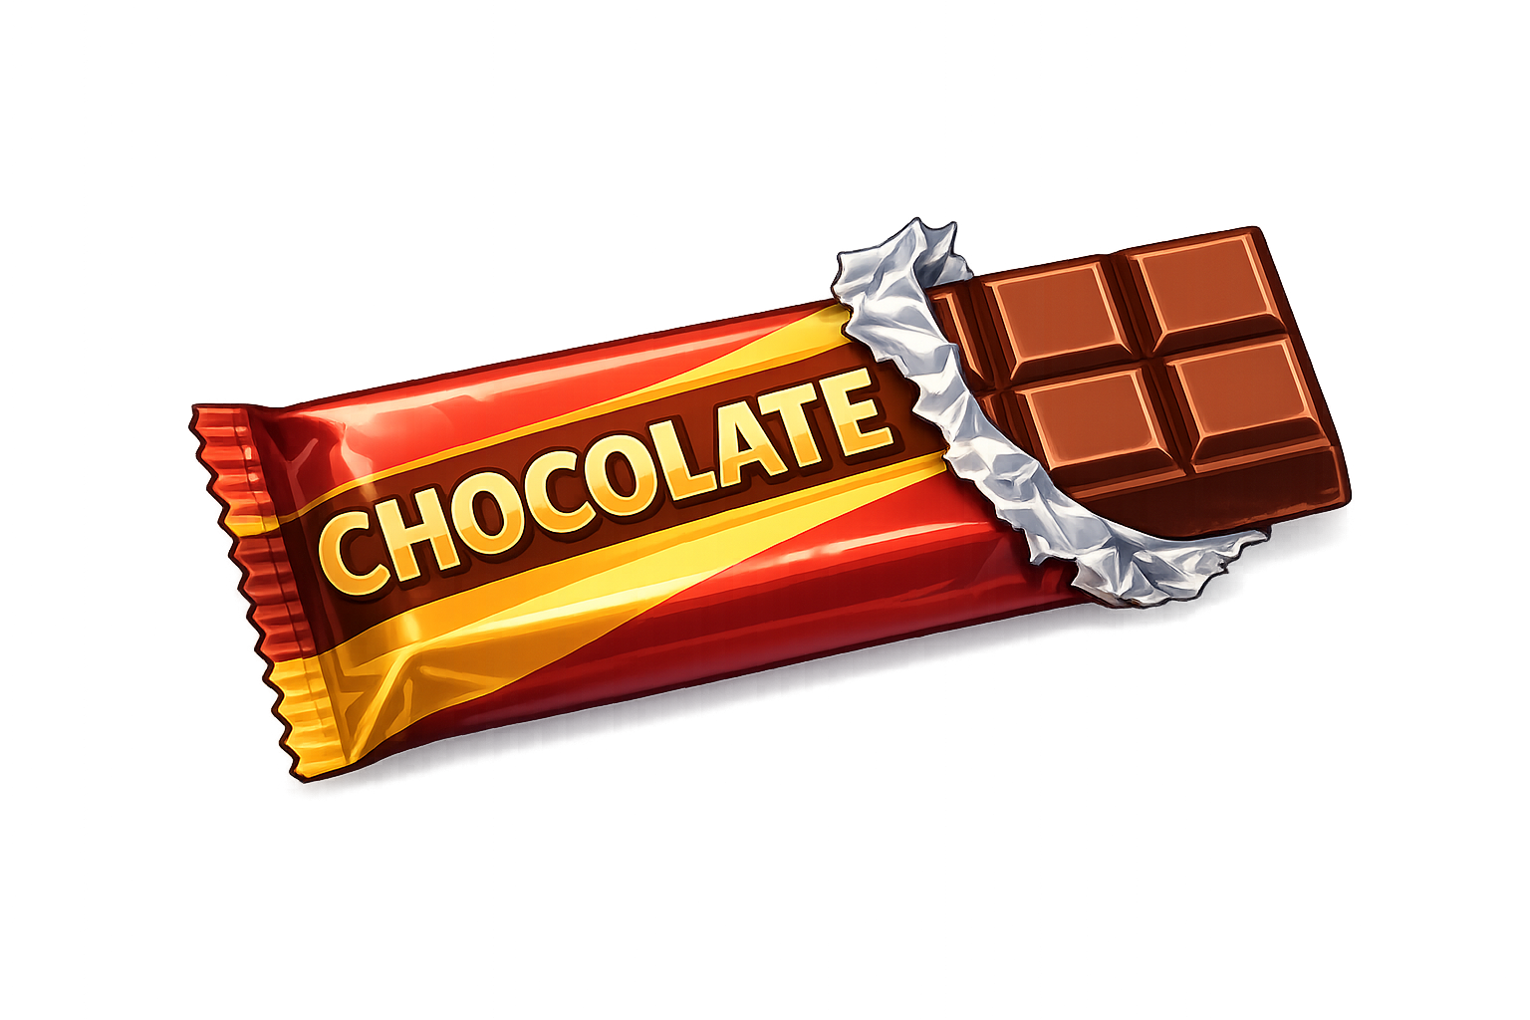
Aisha eats 1/4 of a chocolate bar.
Ben eats 30% of the same size bar.
Who eats more?
Explain how you know
30% > ¼
Ben eats more

Slide 3

Tom has completed 50% of his sticker book.
Maya has completed 0.48 of hers.
Who has
completed more?
50% > 0.48
Tom has completed more.

Slide 4
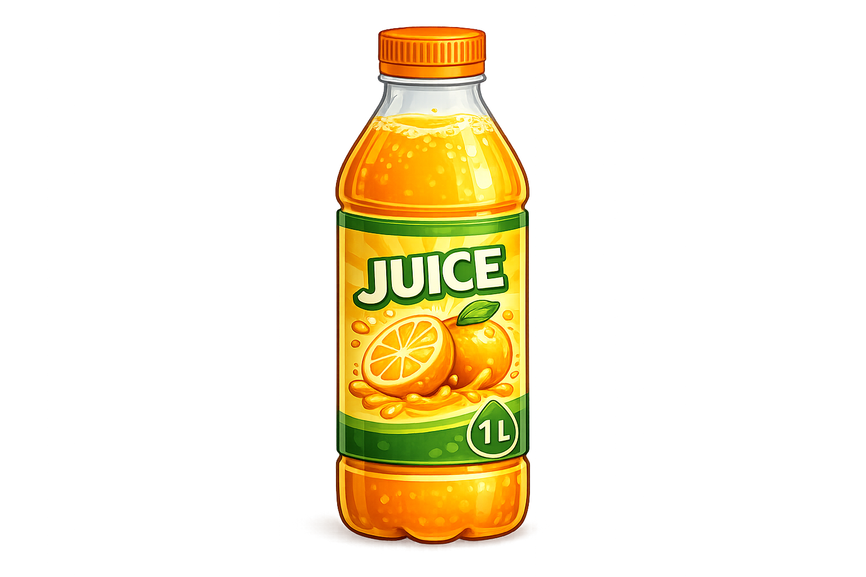
A bottle of juice is 1 Litre full.
Sam drinks 3/5 of his bottle of juice.
Alex drinks 60% of his bottle of juice.
Who drinks more?
3/5 = 60%
They both drink the same

Slide 5


Recap:
Fraction | Decimal | Percentage
9/100
90/100
 |  | 99%
 | 0.01
0.09
9%
0.9
90%
99/100
0.99
1/100
1%

Slide 6
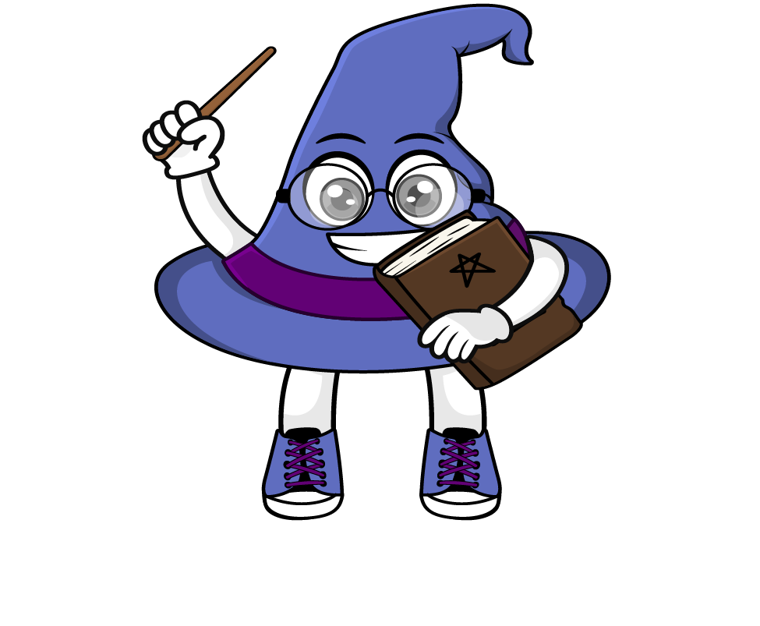
True or False
1/10 = 1%
False: Can you explain why?

