Slide 1


Lesson 3:
Applying percentages in word problems
www.arithmagicians.com

Slide 2

A Shirt costs £50. It is reduced by 10%. What is the new price?
£50
£5
£5
£5
£5
£5
£5
£5
£5
£5
£5
Reduced
New Price

Slide 3
A tank holds 200 Litres of water. It is 90% full. How much water is in the tank?
200 L
20
20
20
20
20
20
20
20
20
20
Full
Empty

Slide 4


Your Turn
A school has 120 pupils. 40% of them walk to school. How many pupils don’t walk to school?
120 Pupils
12
12
12
12
12
12
12
12
12
12
Walk
Don’t Walk

Slide 5
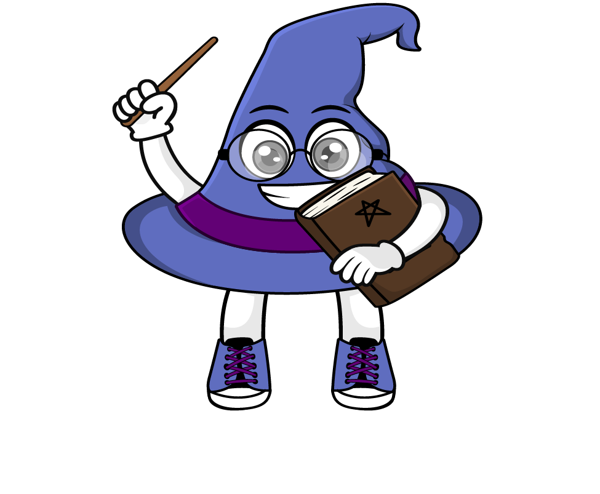
True or False
40% is the same as two fifths.
True

